Slide 1
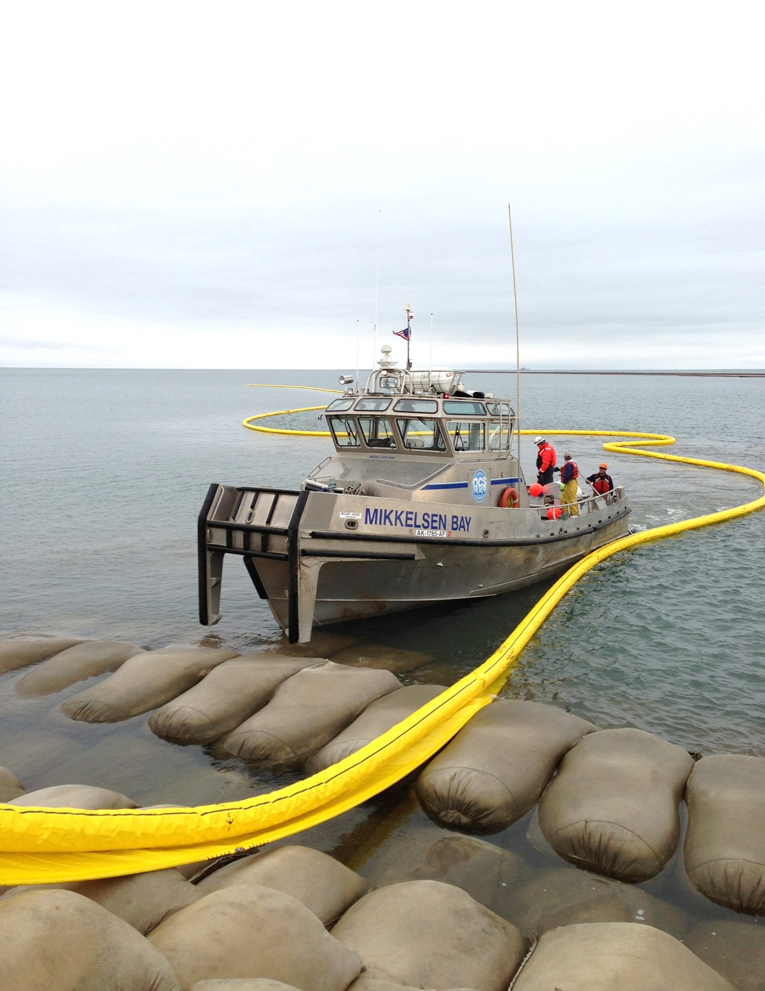
Alaska Clean Seas
Spill Response Equipment Catalog
2022

Slide 2
Printing Instructions:
For best results, set to print in color, two-sided, 8 ½ x 11 inch Letter paper. The inserted blank pages will allow each section break to begin on an odd page.

Slide 3




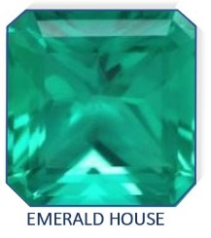



Membership of ACS

Slide 4
This page intentionally left blank.

Slide 5
Introduction
This Manual provides a guide to the location, ownership, type, amount and specifications to North Slope response equipment that Alaska Clean Seas (ACS) utilizes. In 1995, all spill equipment on the North Slope except Alyeska was consolidated, which brought it all into one tracking and maintenance system.
Spill response equipment warehouses, storage yards, and satellite areas are strategically located in each operating field and at two separate locations in Deadhorse. With assistance from ACS Base, field-assigned ACS technicians support the operating area facilities and sites; while the Deadhorse locations are managed by ACS Base personnel.
ACS technicians perform required preventative and routine maintenance activities on both ACS and Member Company dedicated spill response equipment. Equipment repairs beyond the capabilities of ACS technicians are accomplished by mechanics assigned to either ACS Base in Deadhorse/Marine or mechanics at Alpine and Kuparuk. These shops perform complex maintenance tasks and maintain vessels and specialized response equipment. Off-shore marine vessels and equipment are maintained and repaired by Marine mechanics at A4W1. Major equipment modification work and specialized fabrication are also accomplished at these facilities.
Currently, the value of dedicated spill response equipment warehoused under ACS management exceeds $75 million. ACS owns roughly half of this equipment while the Member Companies own the other half. With the exception of repair or maintenance costs, all ACS owned equipment is available to Member Companies at no charge, during a spill response. Member owned equipment is available to all other members under terms and conditions outlined in the North Slope Mutual Aid Agreement.
In summary, ACS maintains a vast amount of equipment located throughout the operating oil fields on the North Slope of Alaska. This manual is intended to assist potential users in understanding ACS spill response equipment and how they might access it for both spill and non-spill related work.
Should there be any questions regarding the equipment, please contact us at (907) 659-2405.

Slide 6
This page intentionally left blank.

Slide 7
Table Of Contents
Safety | Section A
Meters | Page 1
Automated External Defibrillators (AEDs) | Page 2
Emergency Locater Beacons (EPIRB) and Global Position Indicating Radio Beacons (GPIRB) | Page 3
Life Rafts | Page 4
Dry Decons | Page 5
Wet Decons | Page 6
Vessels and Accessories | Section B
Agviq | Page 7
Big Dipper | Page 8
Point McIntyre | Page 9
Bay Boats | Page 10
Fireweed and Arctic Rose | Page 11
Deployer and Retriever | Page 12
Island Boats | Page 13
Bullet and Snow White | Page 14
Large Landing Crafts | Page 15
Small Landing Crafts | Page 16
Near-shore Work Boats | Page 17
Airboats | Page 18
Outboards | Page 19
Recovery Equipment | Section C
LORI Brush Skimmers | Page 20
Vikoma Weir Skimmers | Page 21
Foxtail Rope Mop Skimmer | Page 22
I

Slide 8
Table Of Contents - Continued
Desmi Skimmers (Ocean and Harbor) | Page 23
Disc Skimmers | Page 24
Drum/Brush Skimmers | Page 25
Grooved Drum Skimmer w/Steam Coils and Steam Trailers | Page 26
Crucial Fuzzy Disc Skimmer | Page 27
Crucial Fuzzy Drum Skimmer | Page 28
Lamor Brush Belt Skimmer and Rock Cleaners | Page 29
Skimmer Rope Mops | Page 30
SeaVac Heli-Skimmer | Page 31
Manta Ray Skimmers | Page 32
Vac Units | Page 33
Mini Vac Units | Page 34
Air Power Units | Page 35
Snow Blowers | Page 36
Ice Augers | Page 37
Jackhammers | Page 38
Chainsaws and Ice Trenching Tools | Page 39
Rube Witches | Page 40
Containment | Section D
Delta/River Boom | Page 41
Boom Rudders | Page 42
Boom Handler | Page 43
Shore Seal Boom | Page 44
T-Fence Boom | Page 45
Kepner Boom Reel Packs | Page 46
II

Slide 9
Table Of Contents - Continued
NOFI Ocean Boom | Page 47
NOFI Harbor Buster | Page 48
Ro-Boom | Page 49
Goodyear Ocean Boom | Page 50
Abasco Harbor Boom | Page 51
Lamor Boom Reel Packs | Page 52
Boom Inflating Blowers | Page 53
Floating Pumps - 1 ½ ” | Page 54
Pipe/Culvert Plugs | Page 55
Water Spray Trailer | Page 56
In-Situ Burn Equipment | Section E
Helitorch Gelled Fuel Mixers | Page 57
Handheld Igniters | Page 58
Fire Boom | Page 59
Helitorches | Page 60
Transfer and Storage | Section F
Barges 125 BBL | Page 61
Barges 249 BBL | Page 62
Barge 650 BBL | Page 63
Viscous Oil Annular Injection Kits | Page 64
Fastank/Fold-A-Tanks | Page 65
Self Rising Tanks | Page 66
Floating Tank | Page 67
Upright Tank | Page 68
Bladders | Page 69
III

Slide 10
Table Of Contents - Continued
Heavy Oil Pumps | Page 70
Air Diaphragm Pumps 0.5” to 3” | Page 71
Diesel/Hydraulic Diaphragm Pumps 2” and 3” | Page 72
Gas Diaphragm Pumps 3” | Page 73
Diesel/Hydraulic Peristaltic Pumps 2” , 2 ½” and 3” | Page 74
Sykes Univac Diesel Pumps 3” | Page 75
Centrifugal Pumps 2”, 3” and 4” | Page 76
Emergency Dewatering Pumps 2” | Page 77
Logistics Support Equipment | Section G
Centaur 950DT | Page 78
4-Wheelers | Page 79
Kubotas with Tracks | Page 80
Tucker Sno-Cat | Page 81
Bobcat Tool Cat 5600 | Page 82
Snow Machines and Sleds | Page 83
Muck Truck Motorized Wheelbarrow | Page 84
Passenger/Work Vehicles | Page 85
14 Passenger Bus | Page 86
Medium Duty Flatbed | Page 87
Truck Tractors | Page 88
Boom Trucks | Page 89
Mechanics’ Trailers | Page 90
Dump Truck | Page 91
Dempster System Equipped Trucks | Page 92
Skid Steer Loaders | Page 93
Warehouse Fork Lifts | Page 94
IV

Slide 11
Table Of Contents - Continued
Front End Loaders w/attachments | Page 95
Mobile Command Centers | Page 96
Staging Area Manager Offices | Page 97
Winter Response Vans | Page 98
Tanker Rollover Van | Page 99
Steam Van | Page 100
Warm Up/Break Shacks | Page 101
Portable Shelters | Page 102
Portable Shops | Page 103
Portable Restroom Units | Page 104
Indirect Fired Heaters | Page 105
Under Water Drop Lights | Page 106
Light Plants and Stands | Page 107
Diesel Generators (various) | Page 108
Gas Generators (various) | Page 109
Air Compressors | Page 110
20’ and 40’ Connex | Page 111
Portable Fuel Tanks | Page 112
Communications | Section H
Portable Communications Towers | Page 113
Portable Communications Shelters | Page 114
Handheld Radios | Page 115
Iridium Phones | Page 116
Mobile Radios | Page 117
GPS | Page 118
Gap Fillers | Page 119
Radio Winter Drilling Kits | Page 120
V

Slide 12
Table Of Contents - Continued
Wildlife | Section I
Pinniped Enclosure | Page 121
Bear Cages | Page 122
Net Launchers | Page 123
Wildlife Kits(capture and hazing) | Page 124
PepperBall Gun | Page 125
12 Gauge Shot Guns | Page 126
Bird Stabilization Center | Page 127
Bird Scare Devices | Page 128
Miscellaneous | Section J
De-Icer Ground Penetrating Radar System | Page 129 Page 130
Hydraulic Power Units (various) | Page 131
MegaSecur Dams | Page 132
MetOcean Spill Tracking Systems | Page 133
Underwater ROV | Page 134
Unmanned Aircraft Systems | Page 135
Abbreviations
Abbreviation | Name
ACS | Alaska Clean Seas
CPAI | ConocoPhillps Alaska Inc.
ENI | ENI Alaska
HAK | Hilcorp Alaska
Savant | Savant Alaska
VI

Slide 13
Safety
Section A

Slide 14
This page intentionally left blank.

Slide 15
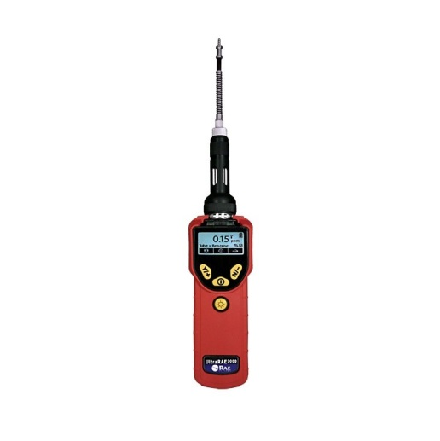
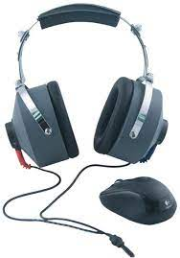
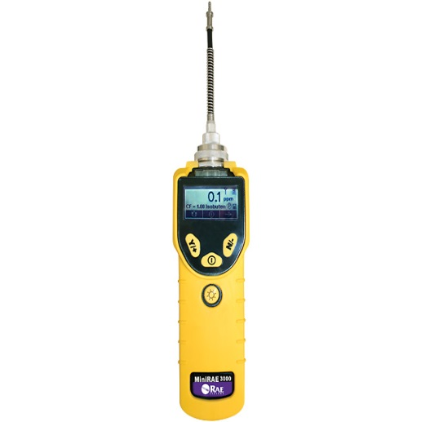
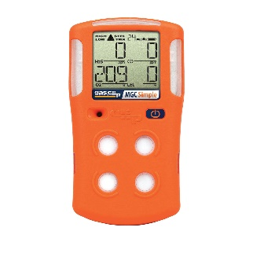
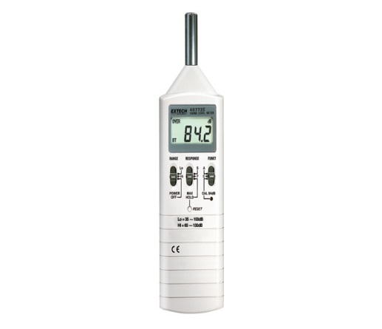
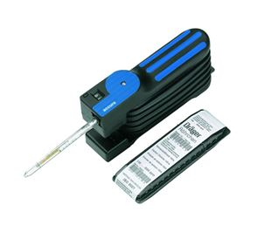
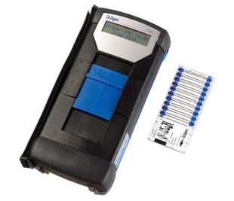
Meters
Quantity: | 20 Total
Manufacturers: | Draeger, Ex Tech, Fit Check, Gas Clip Technologies, and Rae Systems
Owner(s): | (6) Four Gas, ACS |  | (5) PIDs, ACS | (1) Tube Pump, ACS
 | (1) Sound Meter, ACS |  | (1) CMS, ACS | (1) Fit Check Solo, ACS
 | (1) Light Meter, ACS
 | (1) Six Gas, CPAI |  | (1) PID, CPAI
 | (2) Six Gas, HAK
Function: | Air and sound sampling, fit testing and monitoring
1

Slide 16

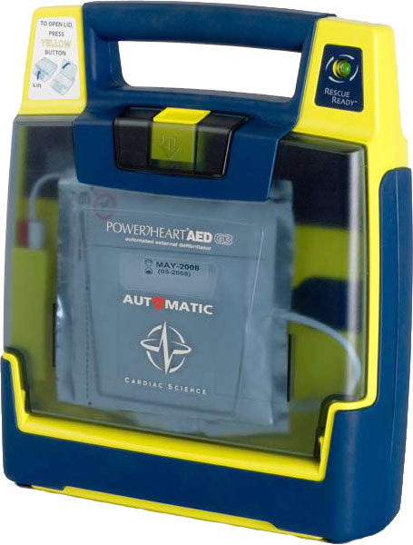
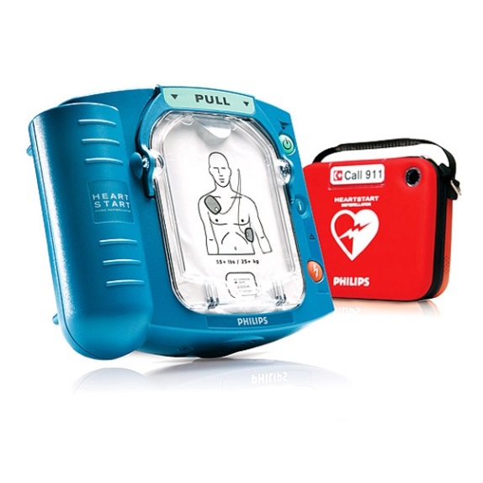
Automated External Defibrillators (AEDs)
Quantity: | 6 Total
Manufacturer: | Cardiac Science and Phillips
Owner(s): | ACS
Specifications: | Cardiac Science-9390A, Phillips 861304, and M5066A
Function: | Emergency first aid.
2

Slide 17
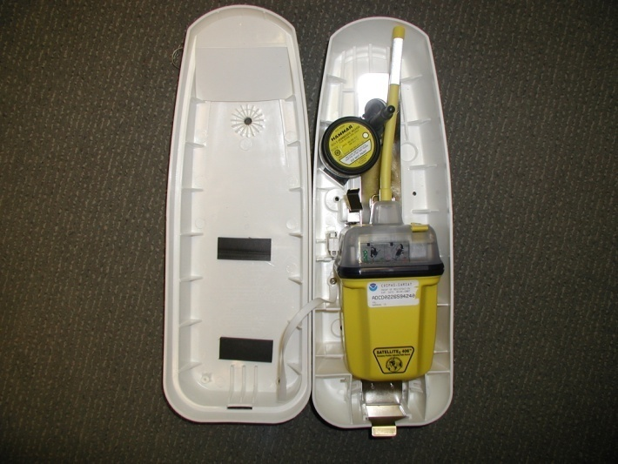
Emergency Locator Beacons (EPIRB and GPIRB)
Quantity: | 15 Total
Manufacturer: | ACR Electronics
Owner(s): | ACS
Specifications: | 406 MHz Satellite, Cat 1, Class 2
Function: | Emergency location of vessels and personnel.
3

Slide 18
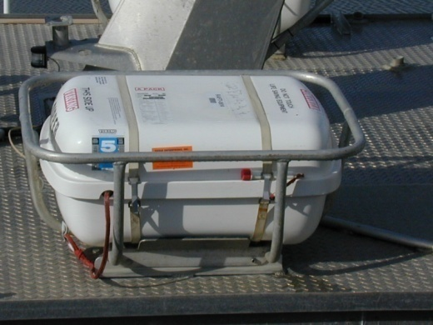
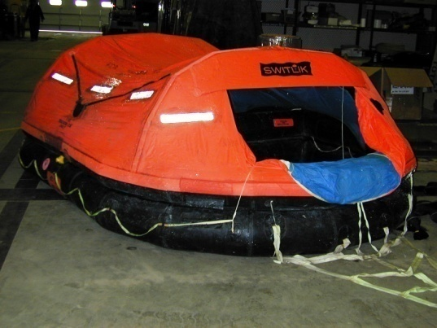
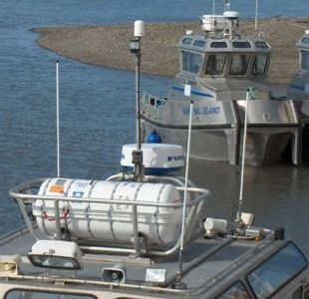
Life Rafts
Quantity: | 36 Total
Manufacturer: | DBC, Guardian and Viking
Owner(s): | 32 each, ACS 4 each, HAK
Specifications: | 6 each, 4 person 11 each, 6 person
 | 15 each, 10 person 4 each, 6 person, HAK
Function: | Life saving equipment for vessels in distress.
4

Slide 19
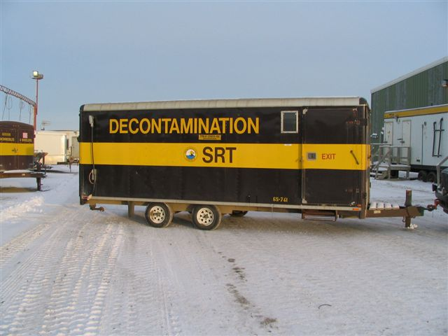
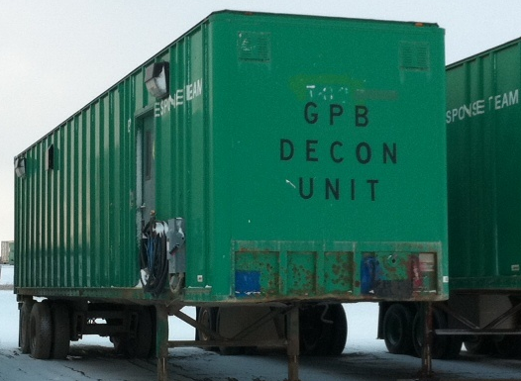
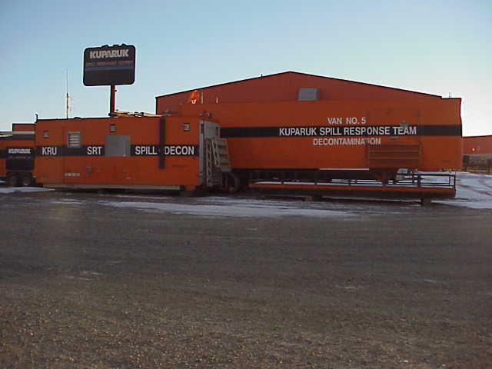
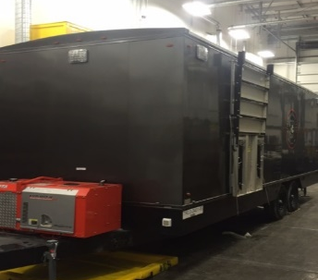
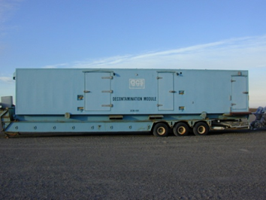
Dry Decons
Quantity: |  | 8 Total
Manufacturer: |  | Alchem, Ameri-can, Fruehauf, Hobbs, Union Cointainer Industries, and Wells Cargo
Owner(s): |  | 2 each, ACS |  | 2 each, CPAI
 |  | 4 each HAK
Specifications: |  | 20’ to 50’ trailer or connex units
Function: |  | Provide dry decon facilities during response operations.
Auxiliary Equip: |  | Generator, Tail Roll Truck or Trailer
5

Slide 20
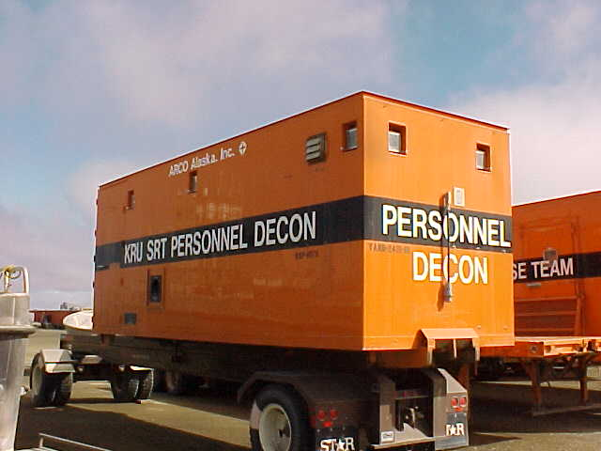
Wet Decons
Quantity: | 1 Total
Manufacturer: | Intercontinental
Owner(s): | CPAI
Specifications: | These self-contained decontamination units are designed to be hauled with either a Dempster system equipped truck or a pickup truck to a spill response site.
Function: | Designed to accommodate either wet or dry decon processes.
Auxiliary Equip: | Generator power for Kuparuk unit: HAK equipped with dedicated generator. Transport truck.
6

Slide 21
Vessels
and
Accessories
Section B

Slide 22
This page intentionally left blank.

Slide 23
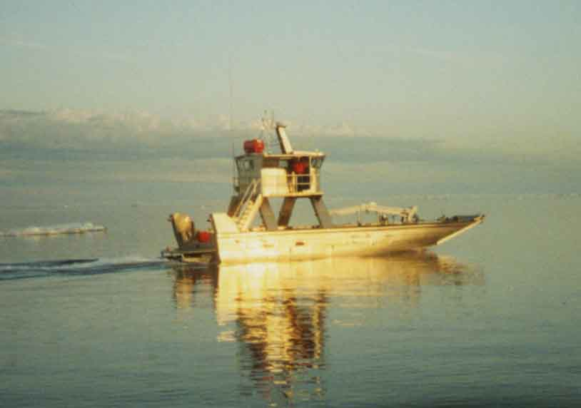
Agviq
Quantity: | 1 Total
Manufacturer: | Grayling Marine
Owner(s): | ACS
Specifications: | Draft: 2’ 6”
 | Fuel Capacity: 900 gallons
 | Twin Lugger, 250 HP each, jets
 | Range: 280 NM @ 2300 RPM w/28 HRS operating time
 | Cruising Speed: 8 -12 kts
 | 55 ft., 45,000 lbs.
Function: | Transporting equipment and personnel, boom deployment and skimming activities.
7

Slide 24
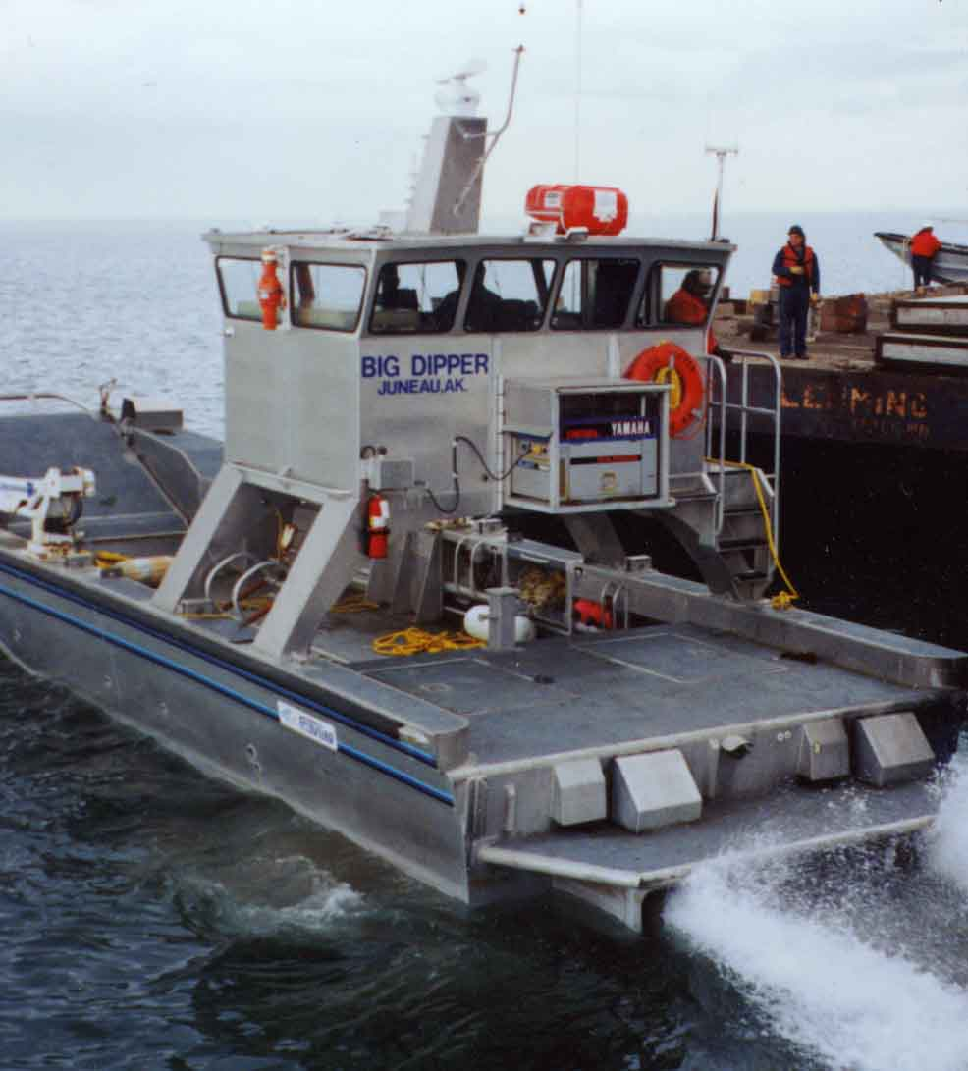
Big Dipper
Quantity: | 1 Total
Manufacturer: | Grayling Marine
Owner(s): | ACS
Specifications: | Draft: 2’6”
 | Fuel Capacity: 632 gallons
 | Twin CAT, 450 HP each, jets
 | Range: 75 NM @ 2400 RPM w/17.5 HRS operating time
 | Cruising Speed: 8 -12 kts
 | 45 ft., 37,000 lbs.
Function: | Transporting equipment and personnel, boom deployment and skimming activities.
8

Slide 25
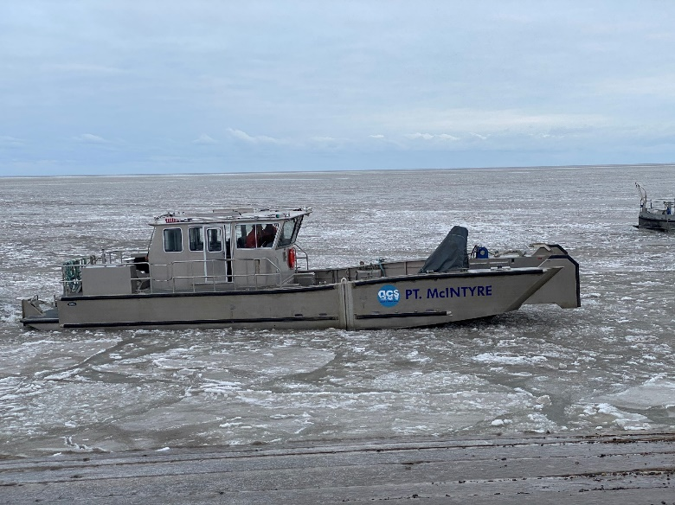
Point McIntyre
Quantity: | 1 Total
Manufacturer: | Munson
Owner(s): | ACS
Specifications: | Draft: 2’8”
 | Fuel Capacity: 500 Gallons
 | Engines: Twin Volvo D13 800HP (Rated 800 BHP @ 2,300 RPM) / Twin Hamilton HJ403 jet drives Persons and Cargo Capacity:12,000 lbs.
 | Range: 127 NM @ 2150 RPM w/12 HRS operating time
 | Cruising Speed: 22-25 Knots@ 2150 to 2200 RPM
 | 48 ft., 45,951 lbs. 16’ beam
Function: | Equipment and personnel transport /deploying and towing open ocean containment boom, operating oil skimmers, towing small oil spill response barges.
9

Slide 26
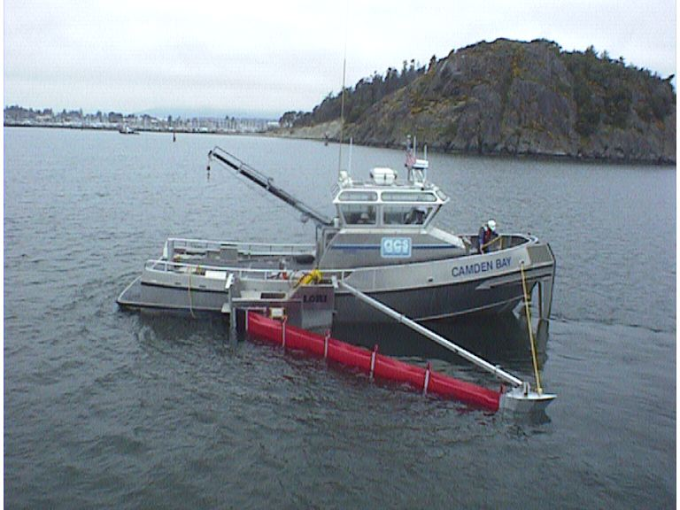
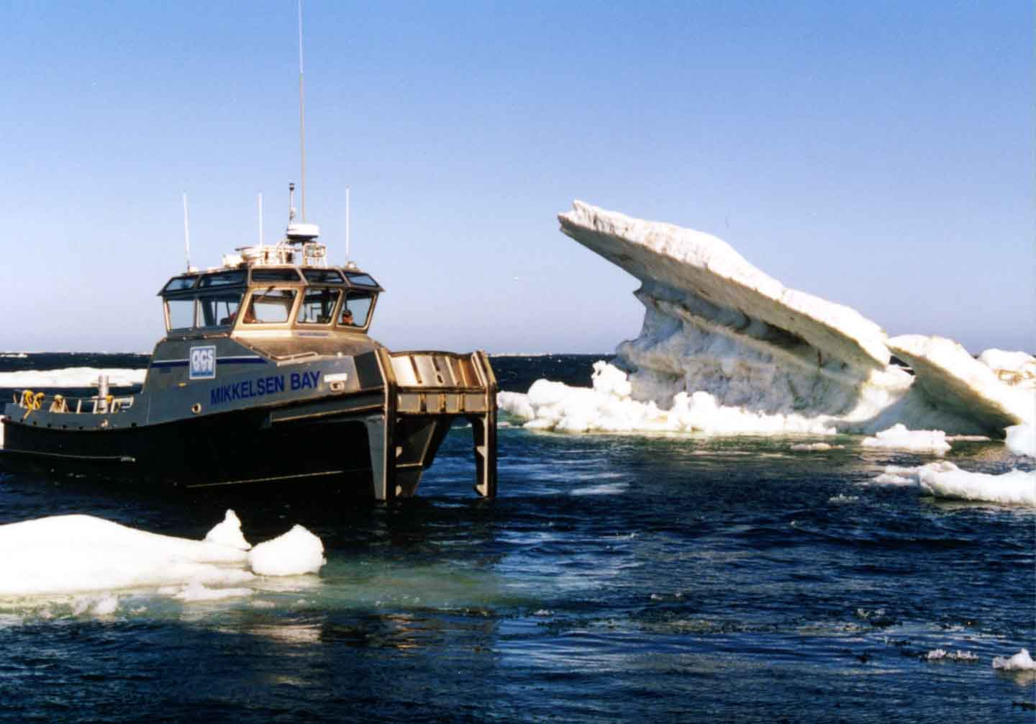
Bay Boats
Quantity: | 3 Total
Manufacturer: | Rozema Boat Works
Owner(s): | ACS
Specifications: | 1 each, Camden Bay, Gwydyr Bay, and Mikkelsen Bay
 | Draft: 3’9”
 | Fuel Capacity: 700 gallons
 | Twin Lugger, 450 HP each, prop
 | Range: 340 NM @ 2,000 RPM w/20 HRS operating time
 | Cruising Speed: 17 kts
 | 42 ft., 37,000 lbs.
Function: | Moving and deploying boom, skimmers, containment barges, and transporting personnel and equipment. The twin engine power supply allows for larger towing capacity and provides increased speed.
10

Slide 27
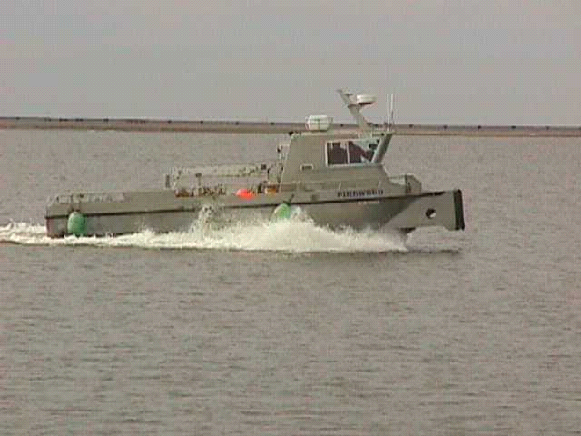
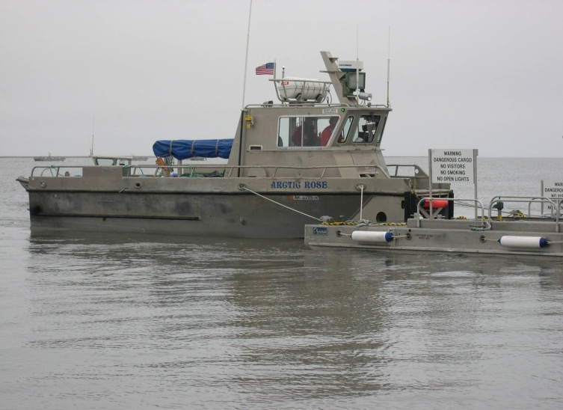
Fireweed and Arctic Rose
Quantity: | 2 Total
Manufacturer: | Munson
Owner(s): | ACS
Specifications: | 1 each, Fireweed and Arctic Rose
 | Draft: 2’8”
 | Fuel Capacity: 650 gallons
 | Twin Cummins, 250 HP each, prop
 | Range: 456 NM @ 2300 RPM w/38 HRS operating time
 | Cruising Speed: 12 kts
 | 38 ft., 30,000 lbs.
Function: | Transporting equipment and personnel, towing boom and mini-barges for spill response.
11

Slide 28
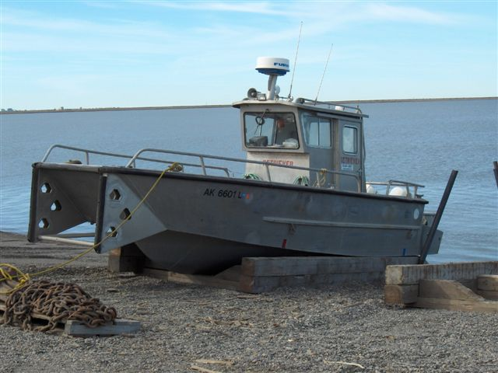
Deployer and Retriever
Quantity: | 2 Total
Manufacturer: | Munson
Owner(s): | ACS
Specifications: | Draft: 2’
 | Fuel Capacity: 200 gallons
 | Twin Evinrude Outboards, 150 HP each, prop
 | Range: 175 NM, 4,000 RPM w/ 7.5 HRS operating time
 | Cruising Speed: 23 kts
 | 29 ft., 9,000 lbs.
Function: | Boom towing, mini-barges, bladders and transport personnel and equipment.
12

Slide 29
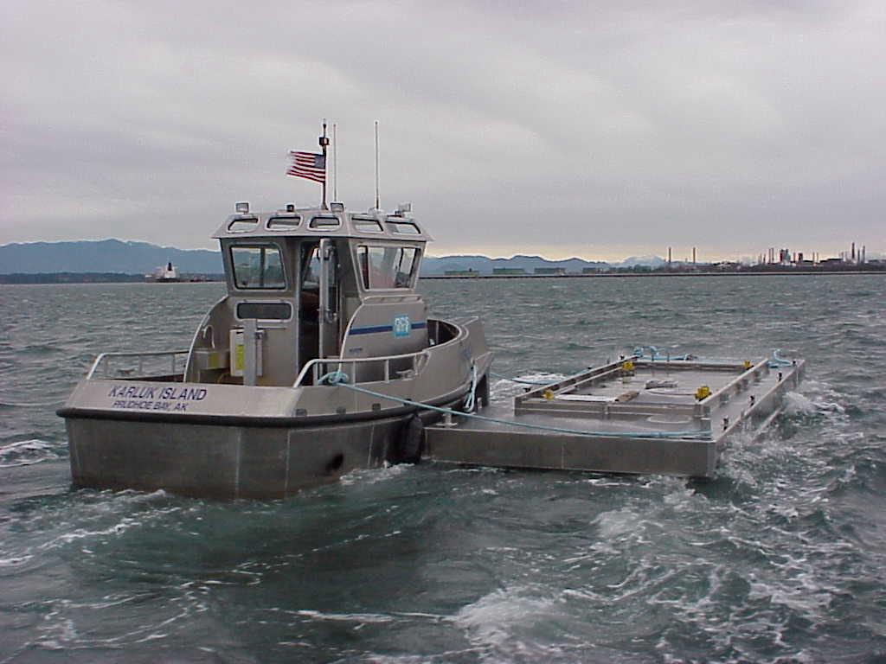
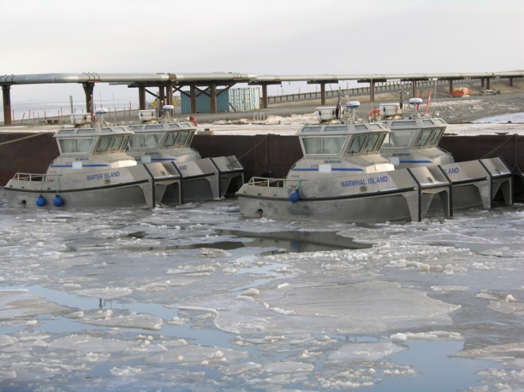
Island Boats
Quantity: | 4 Total
Manufacturer: | Rozema Boat Works
Owner(s): | HAK
Specifications: | 1 each, Karluk Island, Cottle Island, Barter Island and Narwhal Island
 | Draft: 3’9”
 | Fuel Capacity: 172 gallons
 | Single CAT, 300 HP, prop
 | Range: 144 NM @ 2,400 RPM w/12 HRS operating time
 | Cruising Speed: 8 kts
 | 25 ft., 14,800 lbs.
Function: | Boom towing and mini-barge operations.
13

Slide 30
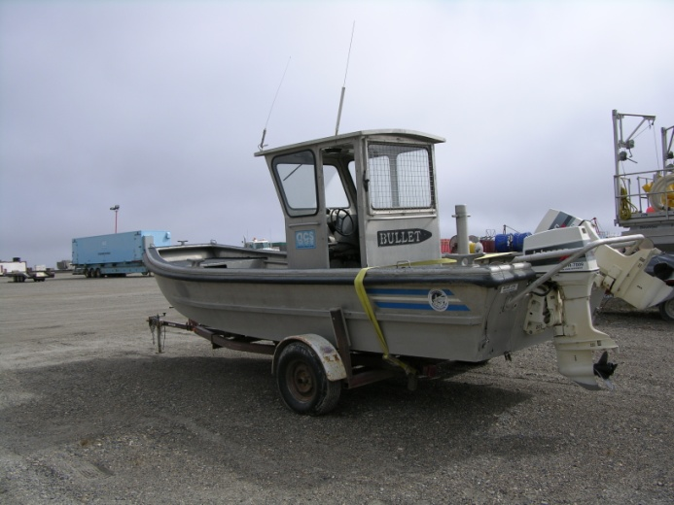
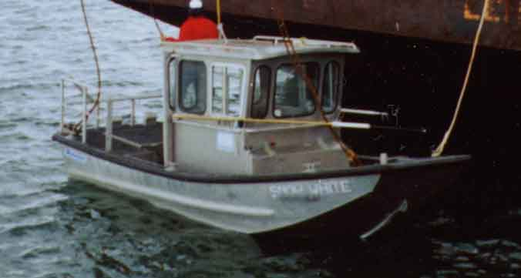
Bullet and Snow White
Quantity: | 2 Total
Manufacturer: | Munson
Owner(s): | ACS
Specifications: | 1 each, Bullet and Snow White
 | Draft: 1’6”
 | Fuel Capacity: 79 gallons, Bullet
 | Fuel Capacity: 147 gallons, Snow White
 | Twin Evinrude Outboards, 90 HP each, prop, Bullet Single Chevrolet 350ci inboard, w/Volvo Penta outdrive, Snow White
 | Cruising Speed: 20 kts
 | 21 ft., 6,000 lbs.
Function: | Near-shore operations to include boom towing.
14

Slide 31
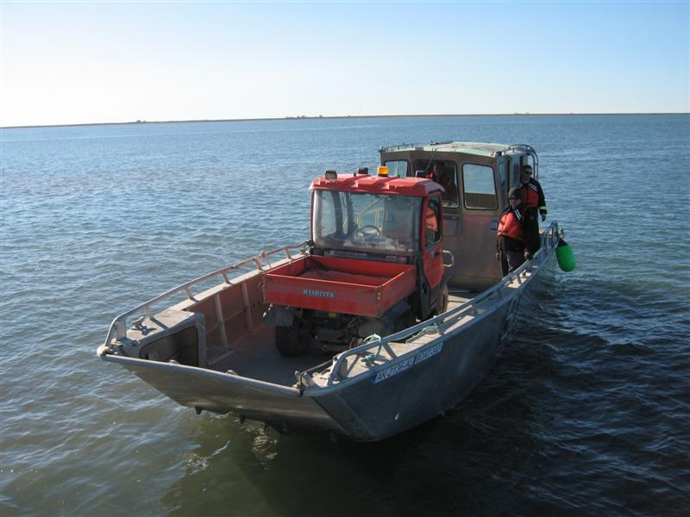
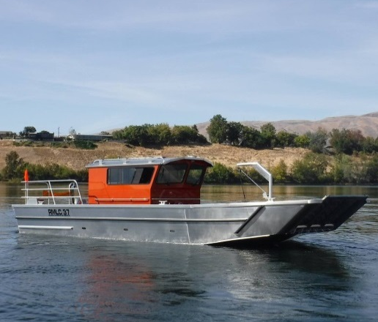
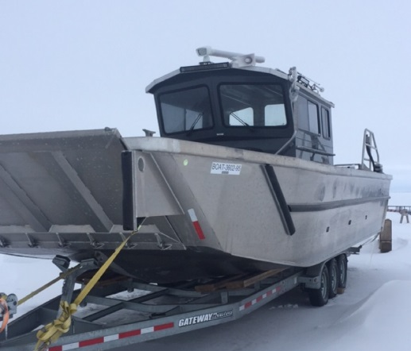
Large Landing Crafts
Quantity: | 4 Total
Manufacturer: | Munson, Riddle
Owner(s): | 1 each, ACS 1 each, CPAI 2 each, HAK
Specifications: | Draft: 20 in. - 2 ft.
 | Fuel Capacity: 300 - 400 gallons
 | Twin Evinrude 300 Outboards, Twin Yanmar 350 Diesel
 | Cruising Speed: 27 - 30 kts
 | 34 ft. - 37 ft., 14,100 lbs. – 18,500 lbs.
Function: | Transporting equipment, personnel, and boom deployment for near-shore response operations.
15

Slide 32
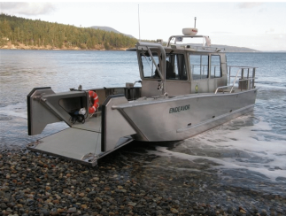
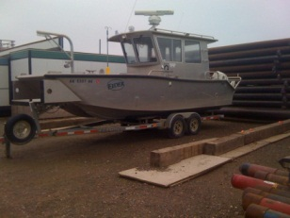
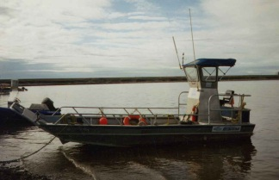
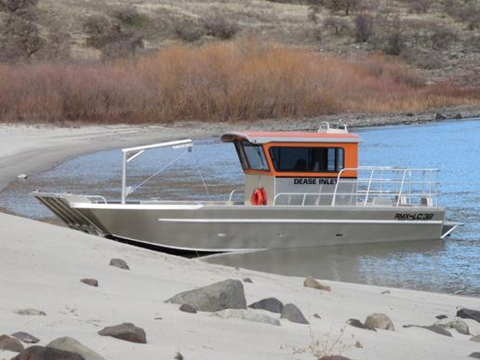
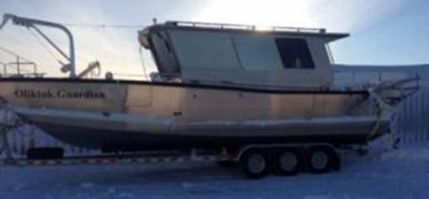
Small Landing Crafts
Quantity: |  |  |  | 6 Total
Manufacturer: |  |  |  | Grayling Marine, Munson and Riddle
Owner(s): |  |  |  | 4 each, ACS |  |  |  | 1 each, CPAI
 |  |  |  | 1 each, HAK
Specifications: |  |  |  | Draft: 1’- 3’
 |  |  |  | Fuel Capacity: 60 - 150 gallons
 |  |  |  | Cruising Speed: 20 - 30 kts
 |  |  |  | 22 to 32 ft., 2,200 lbs. – 12,000 lbs.
Function: |  |  |  | Transporting equipment, personnel, and boom deployment for near-shore response operations.
16

Slide 33
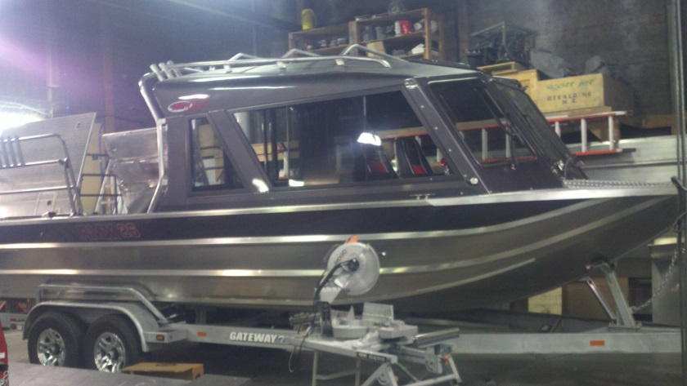
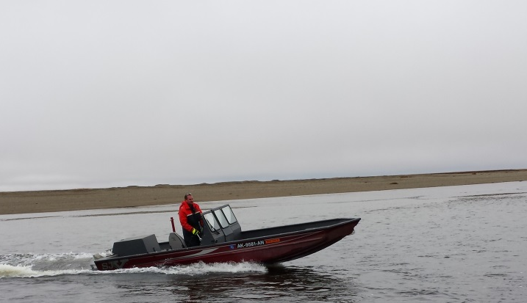
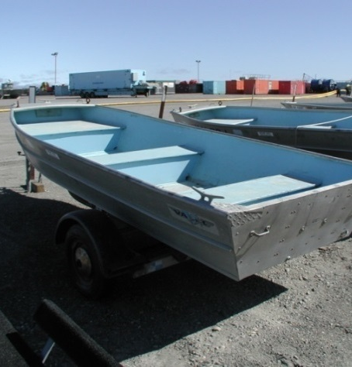
Near-shore Work Boats
Quantity: | 34 Total
Manufacturer: | Achilles, Alaska Frontier Fabricators, Aztec, Gregor, Inmar Inflatables, Lowe, Marian, Munson, Phantom, Sea Ark, Riddle, Rozema, Sea Ark, Sea Nymph, SJX, Smokecraft, Valco, and Woolridge
Owner(s): | 10 each, ACS |  | 16 each, CPAI
 | 1 each, ENI |  | 7 each, HAK
Specifications: | 12’ to 28’ rigid hulled up to 200 HP
Function: | Containment, recovery and logistical support for near-shore response operations.
17

Slide 34
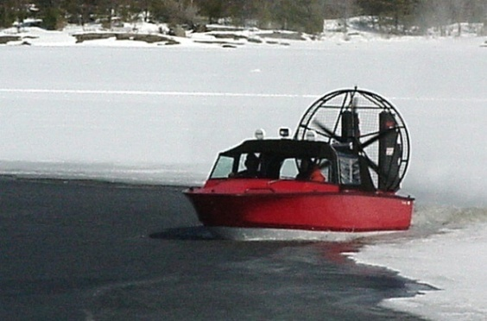
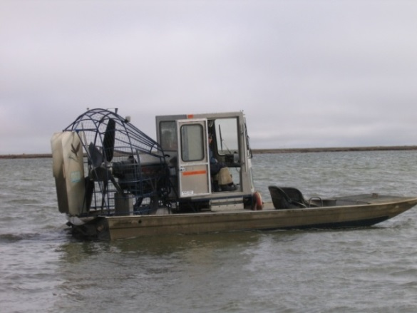
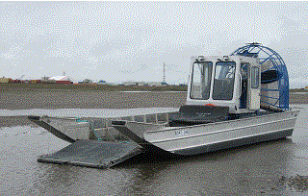
Airboats
Quantity: | 33 Total
Manufacturer: | Alumitech, Diamondback, and Husky
Owner(s): | 16 each, ACS | 5 each, CPAI
 | 12 each, HAK
Specifications: | 19’ - 2 each, ACS
 | 20’ - 1 each, ACS |  | 4 each, HAK
 | 22’ - 11 each, ACS |  | 5 each, CPAI
 | 7 each, HAK
 | 28’ - 2 each, ACS |  | 1 each, HAK
Function: | Transport personnel, equipment and deploy boom in rivers and near-shore response.
18

Slide 35
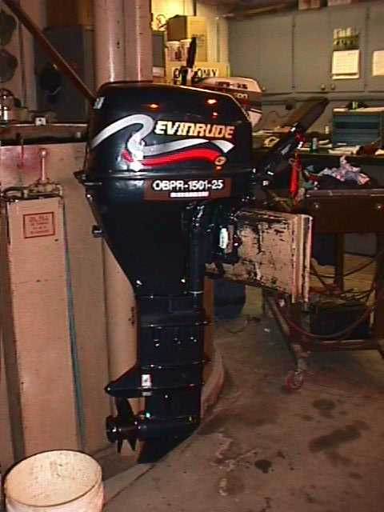
Outboards
Quantity: | 49 Total
Manufacturer: | Evinrude, Honda, Johnson, Prodrive, Suzuki and Yamaha
Owner(s): | 24 each, ACS |  | 10 each, CPAI | 1 each, ENI
 | 13 each, HAK |  | 1 each, Savant
Specifications: | 9 Jet Units: 25 to 115 HP
 | 40 Prop Units: 4 to 300 HP
Function: | Power non-inboard engine vessels.
19

Slide 36
This page intentionally left blank.

Slide 37
Recovery Equipment
Section C

Slide 38
This page intentionally left blank.

Slide 39
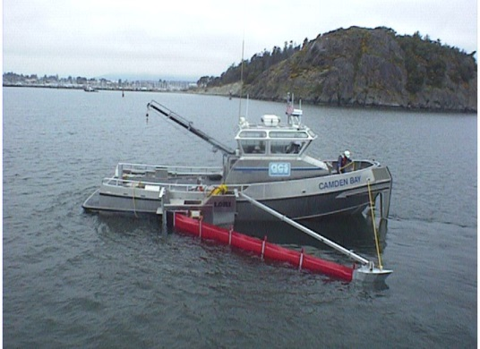
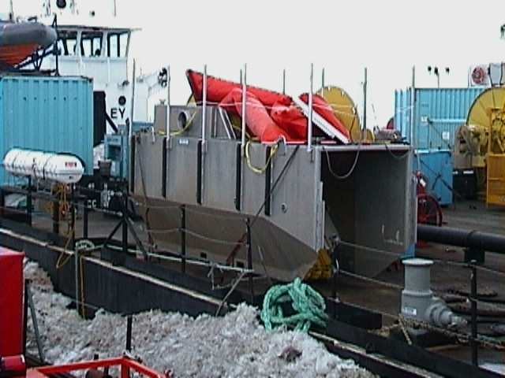
LORI Brush Skimmers
Quantity: | 12 Total
Manufacturer: | LORI
Owner(s): | 10 each, ACS | 2 each, HAK
Specifications: | 8 each, LSC-3 4 each, LFS-3 (without brushes)
 | Nameplate Capacity: 271 BPH Derated Capacity: 217 BPH
Function: | Advancing brush skimmer for the recovery of heavy oils in open ocean conditions. LORI Side Collector (LSC) - Vessel based oleophilic chain brush skimmer designed for advancing skimming operations in the near shore and open ocean environment. Skimmer is capable of recovery speeds up to 3 knots and adaptable to varying oil viscosities via interchangeable brush cassettes. Integral positive displacement Desmi 250 transfer pump capable of pumping highly viscous fluids. LORI Floating Skimmer (LFS) - Independent oleophilic chain brush skimmer designed for advancing skimming operations in the near shore and open ocean environment. Skimmer can effectively be towed, pushed or affixed to the side of a vessel. Skimmer is capable of recovery speeds up to 3 knots and adaptable to varying oil viscosities via interchangeable brush cassettes. Integral positive displacement Desmi 250 transfer pump capable of pumping highly viscous fluids.
Auxiliary Equip: | Hydraulic power pack and vessel for advancing skimmer
20

Slide 40

Vikoma Weir Skimmers
Quantity: | 5 Total
Manufacturer: | Vikoma
Owner(s): | ACS
Specifications: | 4 each, Mini Fasflow 1 each, Fasflow | Nameplate Capacity: 143 BPH Derated Capacity: 29 BPH Nameplate Capacity: 486 BPH Derated Capacity: 97 BPH
Function: | Spill recovery in fast moving water.
Auxiliary Equip: | 3” Diaphragm Pump with Mini or 3” Sykes Univac with Fasflow
21

Slide 41



Foxtail Rope Mop Skimmer
Foxtail 1-6 |  |  | Foxtail 4-9
Quantity: | 3 Total
Manufacturer: | Hendriksen
Owner(s): | ACS
Specifications: | 2 each, Foxtail 1-6 | Nameplate Capacity: 19 BPH Derated Capacity: 15 BPH
 | 1 each, Foxtail 4-9 | Nameplate Capacity: 249 BPH Derated Capacity: 119 BPH
Function: | Near-shore and shore recovery responses. Very good skimmer for broken ice conditions.
Auxiliary Equip: | Hydraulic power pack, recovery tank
22

Slide 42

Desmi Skimmers (Harbor and Ocean)
Quantity: | 3 Total
Manufacturer: | Desmi
Owner(s): | 2 each, ACS | 1 each, CPAI
Specifications: | 2 each, Habor*: | Nameplate Capacity: 440 BPH Derated Capacity: BPH
 | *When changed over to brush : 3 each | Nameplate Capacity changes to: 171 BPH Derated Capacity: 137 BPH 1 with brush kit
 | 1 each, Ocean: | Nameplate Capacity: 628 BPH Derated Capacity: 91BPH
Function: | The Desmi Skimmer is of weir type. Rated for recovery from offshore and near-shore environments.
Auxiliary Equip: | Hydraulic hoses, discharge hoses, power pack or Quattro brush adapter
23

Slide 43



Disc Skimmers
Vikoma Komara Morris Vikoma Komora Star
Quantity: | 25 Total
Manufacturer: | Morris International Trading Ltd. and Vikoma (12k and 30k)
Owner(s): | 5 each, ACS | 3 each, CPAI
 | 17 each, HAK
Specifications: | 1 each, Komara Star Heavy Oil Skimmer | Nameplate Capacity: 20 BPH Derated Capacity: 16 BPH
 | 3 each, MI-11/24: | Nameplate Capacity: 29 BPH Derated Capacity: 3 BPH
 | 8 each, Komara 12K: | Nameplate Capacity: 100 BPH Derated Capacity: 10 BPH
 | 3 each, MI-30: | Nameplate Capacity: 143 BPH Derated Capacity: 10 BPH
 | 10 each, Komara 30K: | Nameplate Capacity: 189 BPH Derated Capacity: 10 BPH
Function: | Near-shore and on-shore use. This skimmer contains three sets of oleophilic (oil attracting) discs. The discs rotate down through the oil layer where free floating oil attaches to the surface of the discs. Inside the skimmer, scrapers remove the oil, which is then pumped to storage containers.
Auxiliary Equip: | Power packs and hoses
24

Slide 44




Drum/Brush Skimmers
Aqua Guard |  |  | Elastec Groovy Drum
Lamor |  |  | Action Petroleum
Quantity: | 36 Total
Manufacturer: | Action Petroleum, Aqua Guard, Elastec American Marine, Komara, and Lamor
Owner(s): | 11 each, ACS | 20 each, CPAI
 | 2 each, ENI | 3 each, HAK
Specifications: | Drums range from 6.5” to 36” Nameplate Capacity: 33 to 314 BPH Derated Capacity: 26 to 110 BPH
Function: | Recovery of refined fuels and crude oil from near-shore and inland waters.
Auxiliary Equip: | Hydraulic or air power sources
25

Slide 45


Grooved Drum Skimmer w/Steam Coils and Steam Trailers
Quantity: | 10 skimmers, 2 steam trailers
Manufacturer: | Elastec American Marine
Owner(s): | 3 each, skimmer, ACS |  | 1 each, skimmer, CPAI
 | 6 each, skimmer, HAK
 | 1 each, trailer, ACS |  | 1 each, trailer HAK
Specifications: | TDS-118 Grooved Nameplate Capacity: 33 BPH Derated Capacity: 7 BPH
 | Magnum 100, 4-Drum skimmer Nameplate Capacity: 228 BPH Derated Capacity: 46 BPH
Function: | Recovery of refined fuels and crude oil near-shore and inland
 | waters, particularly during freeze up conditions.
Auxiliary Equip: | Hydraulic power source and independent pump unit.
26

Slide 46


Crucial Fuzzy Disc Skimmer
Quantity: | 10 Total
Manufacturer: | Crucial
Owner(s): | 9 each, ACS | 1 each, HAK
Specifications: | 4 each, Model 13/24 Nameplate Capacity: 121 BPH Derated Capacity: 24 BPH 6 each, Model 13/30 Nameplate Capacity: 200 BPH Derated Capacity: 40 BPH
Function: | Oil recovery from on water operations.
Auxiliary Equip: | Hydraulic power unit and pump
27

Slide 47

Crucial Fuzzy Drum Skimmer
Quantity: | 6 Total
Manufacturer: | Crucial
Owner(s): | 4 each, ACS | 1 each, ENI |  | 1 each, HAK
Specifications: | Model #1CD18H-36 Nameplate Capacity: 120 BPH Derated Capacity: 24 BPH
Function: | Oil recovery from on water operations.
Auxiliary Equip: | Hydraulic power unit, 3” pump
28

Slide 48


Lamor Brush Belt Skimmers and Rock Cleaners
 |  | Rock Cleaner Attachment
Quantity: | 13 Total
Manufacturer: | Lamor
Owner(s): | 1 each, MM-30, CPAI 8 each, MM-20, CPAI
 | 2 each, Rock Cleaners, CPAI 2 each, LAM 12, ACS
Specifications: | Nameplate Capacity: 75 to 252 BPH Derated Capacity: 60 to 201 BPH
Function: | Recover diesel or crude product from the water or rock surfaces.
Auxiliary Equip: | Hydraulic or air power sources
29

Slide 49



Skimmer Rope Mops
Quantity: | 32 Total
Manufacturer: | Centrifugal Systems, Containment Systems Corporation, Crucial, and Oil Mop
Owner(s): | 14 each, ACS | 9 each, CPAI
 | 8 each, HAK | 1 each, Savant
Specifications: | Electric and diesel powered 4” Rope Mops |  |  | Nameplate Capacity: 14 BPH Derated Capacity: 5 BPH
Function: | Recover hydrocarbons from shallow water, broken ice and tundra in polygonal trenches.
Auxiliary Equip: | Two 4” x100’ mops, two return pulleys and one containment drum with pallet
30

Slide 50

SeaVac Heli-Skimmer
Quantity: | 1 Total
Manufacturer: | Kepner Products
Owner(s): | ACS
Specifications: | Nameplate Capacity: 944 BPH Derated Capacity: 189 BPH
Function: | Advancing weir skimmer for the recovery of heavy or emulsified oils in protected waters.
Auxiliary Equip: | Outboard motor, and 2”-3” trash pumps
31

Slide 51


Manta Ray Skimmers
Quantity: | 47 Total
Manufacturer: | Slickbar
Owner(s): | 3 each, ACS | 16 each, CPAI
 | 28 each, HAK
Specifications: | Nameplate Capacity: 54 BPH Derated Capacity: 11 BPH
 | 10 Flexible 37 Rigid
Function: | Recovery of thin oil layers and sheen in protected waters.
Auxiliary Equip: | 3” Diaphragm pump or Peristaltic pump
32

Slide 52





Vac Units
Quantity: | 7 Total
Manufacturer: | Vikoma, Vac-U-Max
Owner(s): | HAK
Specifications: | Vac-U-Max: |  | TK-01, TK-02, TK-1-B, 23956
 | Vikoma: |  | Power Vac
Function: | Air and diesel driven vacuum units for spill recovery inside fixed structures or flat hard surfaces.
Auxiliary Equip: | Air compressor or auxiliary power unit
33

Slide 53


Mini Vac Units & Tanks
Quantity: | 5 Total Mini Vac Units, 2 Total Tanks
Manufacturer: | Elastec American Marine
Owner(s): | 2 each, ACS |  | 1 each, CPAI
 | 2 each, HAK
 | 1 each, tank, CPAI |  | 1 each, tank, HAK
Specifications: | 20 HP power unit
Function: | Recovery of product in remote, or “off site” locations.
Auxiliary Equip: | 55 gallon open top drums, 110 gallon all-terrain tracked tank, ATV or snow machine for transport
34

Slide 54

Air Power Units
Quantity: | 3 Total
Manufacturer: | Elastec American Marine
Owner(s): | 1 each, ACS | 2 each, CPAI
Specifications: | Diesel powered
Function: | Power unit designed to operate air drum skimmers as an all in one unit. Power unit equipped with air compressor and peristaltic pump.
35

Slide 55

Snow Blowers
Quantity: | 6 Total
Manufacturer: | Honda
Owner(s): | 2 each, ACS | 2 each, CPAI
 | 1 each, ENI | 1 each HAK
Specifications: | Gas operated with the ability to move up to 35 tons/hr of snow. 2.5 hours of operating time per fuel tank
Function: | Remove contamination from the snow surface.
36

Slide 56


Gas and Propane Powered Ice Augers
Quantity: | 39 Total
Manufacturer: | Ardisam, Feldman Engineering, General Equipment Co., and Strike Master
Owner(s): | 7 each, ACS | 12 each, CPAI | 3 each, ENI
 | 16 each, HAK | 1 each, Savant
Specifications: | One and two person units 34 CC to 102 CC
Function: | Drill through ice to the water interface. This technique is used for product detection and recovery.
Auxiliary Equip: | Bits and extensions
37

Slide 57


Jackhammers
Quantity: | 20 Total
Manufacturer: | DeWalt and Ingersoll Rand
Owner(s): | 6 each, ACS | 3 each, CPAI | 5 each, ENI
 | 5 each, HAK | 1 each, Savant
Specifications: | One and two person units 13 each, air powered 7 each, electric
Function: | Break up contaminated ice or ground for recovery.
Auxiliary Equip: | Compressor or generator, hose, whip check, paddles/bits, tanner gas.
38

Slide 58



Chainsaws and Ice Trenching Tools
Quantity: | 49 Total (chainsaws)
Manufacturer: | Homelite-Textron and Stihl
Owner(s): | 11 each, ACS |  | 13 each, CPAI
 | 4 each, ENI |  | 21 each, HAK
Specifications: | 18” to 48” chainsaw bar
Function: | Trench and remove ice for winter containment and recovery.
Note: | Various chipping bars and ice tongs are stocked at each location
39

Slide 59



Rube Witches
Quantity: | 9 Total
Manufacturer: | ACS
Owner(s): | 7 each, ACS |  | 2 each, CPAI
Specifications: | 36” chainsaw bar required
Function: | Cut trenches in the ice or to cut out blocks of ice to be used in recovery techniques. Provides a safe platform for chainsaw use.
Auxiliary Equip: | Stihl 056 or 066 chain saw with ice cutting chain
40

Slide 60
This page intentionally left blank.

Slide 61
Containment
Section D

Slide 62
This page intentionally left blank.

Slide 63

Delta/River Boom
Quantity: | 203,776 ft.
Manufacturer: | Abasco, American Boom, American Marine, Containment Systems Inc., D.U. Inc., Elastec, Elastec American Marine, Lamor, SG&J Loxley AL, Texas Boom Company, and USA MFG
Owner(s): | 60,500 ft., ACS | 55,926 ft., CPAI
 | 79,700 ft., HAK | 7,650 ft., Savant
Specifications: | 10”, 14” and 16” x 50’ and 75’ Sections Delta Boom- Bottom Tension only - 28,850 ft. River Boom- Top and Bottom Tension- 174,926 ft.
Function: | Containment and control of oil in a river environment. Pre-staged at remote river sites in connexs for airboat deployment.
Auxiliary Equip: | Connexs, anchors and airboats
41

Slide 64

Boom Rudders
Quantity: | 90 Total
Manufacturer: | Envirotech
Owner(s): | ACS
Specifications: | 8” diameter x 80” pipe with 12” x 60” deflector wing
Function: | River booming without the use of midpoint anchor systems.
Auxiliary Equip: | River boom
42

Slide 65

Boom Handler
Quantity: | 1 Total
Manufacturer: | Seacor Environmental Products
Owner(s): | ACS
Specifications: | 60” Roller
Function: | Recovery of oil spill containment boom.
43

Slide 66

Shore Seal Boom
Quantity: | 21,650 ft., Total
Manufacturer: | Texas Boom and Versa Tech
Owner(s): | 16,900 ft., ACS | 1,750 ft., CPAI
 | 1,000 ft., HAK | 2,000 ft., ENI
Specifications: | 20” x 50’ sections
Function: | Shoreline protection or used as barriers for on land flushing operations.
Auxiliary Equip: | Air inflator and water pump
44

Slide 67

T- Fence Boom
Quantity: | 492 ft., Total
Manufacturer: | Harbo Technologies
Owner(s): | ACS
Specifications: | 2.25’ x 82.021’ sections
Function: | Light weight one time use boom for Shoreline protection.
Auxiliary Equip: | Anchors and airboats
45

Slide 68

Kepner Boom Reel Packs
Quantity: | 33,500 ft., Total
 | 20” – 4,750 ft. | 26” – 25,750 ft. | 32” – 2,000 ft. |  | 42” – 1,000 ft.
Manufacturer: | Kepner
Owners: | 23,250 ft., ACS 1,750 ft., (26”), CPAI
 | 5,000 ft., (20”), ENI 3,500 ft., (26”) HAK
Specifications: | 20” to 42” x 250’ to 1,500’ per reel
Function: | Rapid deployment of boom from shore or support vessel.
Auxiliary Equip: | Hydraulic power pack and hoses
46

Slide 69



NOFI Ocean Boom
Quantity: | 5,904 ft. Total
Manufacturer: | Allmaritim
Owner(s): | 2,952 ft., ACS |  | 984 ft., ENI |  | 1,968 ft., HAK
Specifications: | 5 each, Model 250 – 24”, 984 ft. sections 2 each, Model 350 – 34”, 492 ft. sections
Function: | Designed for easy transportation and rapid deployment.
47

Slide 70

NOFI Harbor Buster
Quantity: | 2 Total
Manufacturer: | NOFI
Owner(s): | HAK
Size: | 89 ft. long x 50 ft. wide at the mouth
Tow Speed: | 3 kts
Max Volume: | Total: 3,963 gallons |  |  | In Separator: 1,321 gallons
Function: | Designed for recovery of oil at high speeds in open water. Rear pocket separates oil from water and provides a calm recovery point for a skimmer. This can also be used in rivers of sufficient depth that do not exceed 3 kts.
Auxiliary Equip: | Boom reel pack, power pack, blower, Boom Vane, tow vessel(s)
48

Slide 71



Ro-Boom
Quantity: | 2,360 ft., Total
Manufacturer: | Ro-Clean Desmi
Owner(s): | HAK
Specifications: | 59”
Function: | Containment of product in waters deeper than 6 ft.
Auxiliary Equip: | Hydraulic power pack and hoses
49

Slide 72


Goodyear Ocean Boom
Quantity: | 14,300 ft., Total
Manufacturer: | Engineered Fabrics Corporation
Owner(s): | ACS
Specifications: | 42” inflatable
Function: | Containment of product in waters deeper than 6 ft.
Auxiliary Equip: | Power pack, blower and hydraulic hoses
50

Slide 73


Abasco Harbor Boom
Quantity: | 2,000 ft., Total
Manufacturer: | Abasco
Owner(s): | CPAI |  | .
Specifications: | 30” Self–inflating, high tensile strength, unsinkable
Function: | Containment of product in a near-shore and offshore environment.
51

Slide 74

Lamor Boom Reel Packs
Quantity: | 2 Total
Manufacturer: | Lamor Corporation
Owner(s): | ACS
Specifications: | 50” x 1500’ per reel
Function: | Rapid deployment and storage of Lamor boom.
Auxiliary Equip: | Self contained with power pack and blower on reel. Power pack also set up to run DOP pumps.
52

Slide 75

Boom Inflating Blowers
Quantity: | 51 Total
Manufacturer: | Echo, Husqvarna and Stihl
Owner(s): | 36 each, ACS 4 each, ENI | 5 each, CPAI 6 each, HAK
Specifications: | 388 CFM 180 Air Speed at Pipe
Function: | Boom inflation.
53

Slide 76

Floating Pumps 1 1/2”
Quantity: | 51 Total
Manufacturer: | Waterous and Hale
Owner(s): | 36 each, ACS | 4 each, CPAI
 | 2 each, ENI | 6 each, HAK
Specifications: | 140 GPM @ 30 psi: 200 BPH @ 30 psi
Function: | Fill shoreseal boom with water.
Auxiliary Equip: | Discharge hose
54

Slide 77






Pipe/Culvert Plugs
Quantity: | 19 Total
Manufacturer: | Cherne and Aero Tech Labs
Owner(s): | 6 each, ACS | 13 each, HAK
Specifications: | 1 – 6”, 1 – 8”, 2 – 12 to18”, 7 - 12 to 24”, 2 - 15 to 30”, 6 - 40”
Function: | Block pipes or culverts to provide containment during a response.
Auxiliary Equip: | Air compressor and hose
55

Slide 78

Water Spray Trailer
Quantity: | 1 Total
Manufacturer: | Magnum Fire Systems
Owner(s): | ACS
Specifications: | 12’ trailer with insulated and heated housed fire pump water spray
 | system. Powered by a 4 cylinder air cooled Deutz diesel engine
 | and consists of a 300 gallon fresh water tank.
Function: | Contain misted oil over a snow covered surface for mechanical
 | recovery, particularly when high winds are expected to prevent
 | the misted snow from blowing away.
56

Slide 79
In-Situ Burn Equipment
Section E

Slide 80
This page intentionally left blank.

Slide 81


Helitorch Gelled Fuel Mixers
Quantity: | 2 Total
Manufacturer: | Simplex
Owner(s): | ACS
Specifications: | 300 gallons, 1 each trailer mounted and 1 each skid mounted
Function: | Mix gelled fuel for aerial helitorches. Not DOT approved, must be filled onsite
57

Slide 82


Handheld Igniters
Quantity: | Approximately 1,000 units
Manufacturer: | Elastec and Energetex
Owner(s): | ACS
Specifications: | Tin can style with hand held igniter Plastic container filled with gelling agent with float
Function: | Hand held igniter for in-situ burning.
Auxiliary Equip: | Battery pack or an ignition source, handheld flare, fuel
58

Slide 83




Fire Boom
Quantity: | 19,900 ft., Total, (500’ of this is training boom)
Manufacturer: | 3M, Applied Fabrics, and Elastec American Marine
Owner(s): | 16,100 ft., ACS |  | 1,000 ft., CPAI
 | 2,800 ft., HAK
Specifications: | Sizes ranging from 20” to 42” 3 M – 10,400 ft. - 20” to 42” Elastec - 6500 ft. - 27” to 33” Hydro Boom Applied - 3000 ft. - 30” Pyro Boom
Function: | Containment of product for in-situ burning.
Auxiliary Equip: | Tow bridles and boat for deployment and means of towing 500’ of Elastec training boom, not suitable for response.
59

Slide 84



Helitorches
Quantity: | 6 Total
Manufacturer: | Simplex
Owner(s): | ACS
Specifications: | 55 gallon
Function: | Ignition of hydrocarbon products during in-situ burn operations.
Auxiliary Equip: | Helicopter remote control box, spare 55 gallon drums
60

Slide 85
Transfer and Storage
Section F

Slide 86
This page intentionally left blank.

Slide 87

Barges 125 BBL
Quantity: | 2 Total
Manufacturer: | North Wind Marine
Owner(s): | ACS
Specifications: | Draft: 1’ empty, 3’ full 125 bbls, 29’ x 10’x 5’ 5,200 lbs.
Function: | Storage and transportation of product from skimming vessels to off loading point.
Auxiliary Equip: | Off loading pumps
61

Slide 88



Barges 249 BBL
Quantity: | 13 Total
Manufacturer: | Kvichak Marine Industries
Owner(s): | 10 each, ACS | 3 each, HAK
Specifications: | Draft: 1’ empty, 4’ full 249 bbls, 40’ x 11’ x 5’6” 10,875 lbs.
Function: | Storage and transportation of product from skimming vessels to off loading point.
Auxiliary Equip: | Off loading pumps
62

Slide 89

Barge 650 BBL
Quantity: | 1 Total
Manufacturer: | American Eagle
Owner(s): | ACS
Specifications: | Draft: 1’ empty, 5’ 6” full 650 bbls, 62’ x 16 ’ x 6’6” 35,000 lbs.
Function: | Storage and transportation of product from skimming vessels to off loading point.
Auxiliary Equip: | Off loading pumps and hydraulic power unit
63

Slide 90


Viscous Oil Annular Injection Kits
Quantity: | 4 Total
Manufacturer: | Hyde and Ro-Clean Desmi
Owner(s)/Location: | ACS
Specifications: | 1 each, 3” annular injection rings 1 each, 4” annular injection rings 2 each, 6” annular injection rings
Function: | Enhance viscous oil pumping capabilities.
Auxiliary Equip: | Discharge hose, hydraulic power pack and water injection pump, cargo pump
64

Slide 91

Fastank/Fold-A-Tanks
Quantity: |  |  | 170 Total
Manufacturer: |  |  | Areo Tech, The Eldred Environmental, Fast Engineering, Fold-A-Tank, and Vikoma
Owner(s): |  |  | 34 each, ACS | 78 each, CPAI | 6 each, ENI
 |  |  | 46 each, HAK | 6 each, Savant
Specifications: |  |  | Fastank/Fold-A-Tanks/Open Top Tank 400 to 3,000 gallons
Function: |  |  | Temporary storage of recovered product.
65

Slide 92

Self Rising Tanks
Quantity: | 48 Total
Manufacturer: | Canflex
Owner(s): | 10 each, ACS | 38 each, CPAI
Specifications: | Self rising, 2,500 gallons
Function: | Temporary storage of recovered product.
66

Slide 93

Floating Tank
Quantity: | 1 Total
Manufacturer: | Qualitech Environmental
Owner(s): | CPAI
Specifications: | 2100 gallons
Function: | This tank can be placed under a leaking pipeline that is over a body of water. The tank is secured in place with anchors. This can also be used on tundra.
67

Slide 94

Upright Tank
Quantity: | 1 Total
Manufacturer: | ConocoPhillips
Owner(s): | CPAI
Specifications: | 16,800 gallons: 400 bbls, plus approximately 150 additional tanks available on the Slope ranging in size from 40 to 500 bbls.
Function: | Storage of recovered product and flushing operations.
68

Slide 95

Bladders
Quantity: | 24 Total
Manufacturer: | Canflex and Areo Tech Labs
Owner(s): | 2 each, 500 gal., ACS |  | 3 each, 500 gal., CPAI
 | 8 each, 1,320 gal., ACS |  | 6 each, 2,640 gal., ACS
 | 5 each, 5,000 gal., CPAI
Specifications: | 500 to 5,000 gallons, Towable, Pillow, Tow/Lift
Function: | Store and transport recovered product.
Auxiliary Equip: | Boat, helicopter
69

Slide 96
Heavy Oil Pumps
Quantity: | 21 Total
Manufacturer: | Desmi, Lamor and Elastec American Marine
Owner(s): | 18 each, ACS | 2 each, HAK
 | 1 each, CPAI
Specifications: | 3”- 2 each, 110 GPM, 157 BPH 3”- 2 each, 132 GPM, 188 BPH 6”- 17 each, 440 GPM, 628 BPH
Function: | Transferring heavy oils.
Auxiliary Equip: | Hydraulic power pack, double hose reel with discharge and hydraulic hoses. Light oil adapter and water injection kits.
70

Slide 97

Air Diaphragm Pumps ½”, 1”, 2” and 3”
Quantity: | 20 Total
Manufacturer: | Ingersoll-Rand and Wilden
Owner(s): | 6 each (1/2”), HAK |  | 6 each (1”), HAK
 | 6 each (2”), HAK |  | 1 each (2”), ENI
 | 1 each (3”), CPAI
Specifications: | 15 to 260 GPM, 21 to 371 BPH
Function: | Transfer of product from a recovery point to a set storage area.
Auxiliary Equip: | Air compressor, air hose and suction/discharge hose
71

Slide 98


Diesel/Hydraulic Diaphragm Pumps 2” and 3”
Quantity: | 50 Total
Manufacturer: | Aqua Guard, Gormann Rupp, and Yanmar
Owner(s): | 32 each, ACS | 7 each, CPAI
 | 3 each, ENI | 8 each, HAK
Specifications: | 3 each, 2” diesel pumps |  | 1 each, 2” hydraulic pump
 | 40 each, 3” diesel pumps 6 each, 3” hydraulic pumps 86-100 GPM, 123-142 BPH
Function: | Transfer of product from a recovery point to a set storage area.
Auxiliary Equip: | Suction and discharge hose
72

Slide 99

Gas Diaphragm Pumps 3”
Quantity: | 12 Total
Manufacturer: | Homelite-Textron and Honda
Owner(s): | 9 each, CPAI | 3 each, HAK
Specifications: | 80 GPM, 114 BPH
Function: | Transfer of product from a recovery point to a set storage area.
Auxiliary Equip: | Suction and discharge hose
73

Slide 100


Diesel/Hydraulic Peristaltic Pumps 2”, 2 ½”, and 3”
Quantity: | 19 Total
Manufacturer: | Diesel America West and Salaroll
Owner(s): | 7 each, ACS | 6 each, CPAI
 | 2 each, ENI | 4 each, HAK
Specifications: | 53-115 GPM, 75-164 BPH
Function: | Transfer of product from a recovery point to a set storage area.
Auxiliary Equip: | Suction and discharge hose
74

Slide 101

Sykes Univac Diesel Pump 3”
Quantity: | 1 Total
Manufacturer: | Sykes
Owner(s): | ACS
Specifications: | 340 GPM, 485 BPH
Function: | Transfer of product from a recovery point to a set storage area.
Auxiliary Equip: | Suction and discharge hose
75

Slide 102



Centrifugal Pumps 2”, 3” and 4”
Quantity: | 115 Total
Manufacturer: | Diesel America West, Elastec American Marine, Gorman-Rupp, Honda, Multi-Quip, and Yanmar
Owner(s): | 52 each, ACS | 28 each, CPAI
 | 2 each, ENI | 31 each, HAK
 | 2 each, Savant
Specifications: | 2 each, 1”, 32 GPM, 46 BPH Gas 2 each, 1 ½”, 74 GPM, 106 BPH Gas 30 each, 2” up to 220 GPM, 314 BPH 56 each, 3” up to 400 GPM, 571 BPH 17 each, 4” 370-750 GPM, 528-1,071 BPH
 | 8 each, 4” Fire Boom Pumps, Elastec American Marine
Function: | Transfer of product from a recovery point to a set storage area.
Auxiliary Equip: | Suction and discharge hose
76

Slide 103


Emergency Dewatering Pumps 2”
Quantity: | 6 Total
Manufacturer: | Ohler Machinery
Owner(s): | ACS
Specifications: | 230 GPM, 329 BPH
Function: | Emergency dewatering pump for vessels in distress.
Auxiliary Equip: | Suction and discharge hose
77

Slide 104
This page intentionally left blank.

Slide 105
Logistics Support Equipment
Section G

Slide 106
This page intentionally left blank.

Slide 107

Centaur 950DT
Quantity: | 3 Total
Manufacturer: | Ontario Drive & Gear Limited
Owner(s): | 2 each, CPAI 1 each, HAK
Specifications: | Diesel powered amphibious tracked vehicle.
Function: | All-season cross-country transportation of equipment and personnel.
Auxiliary Equip: | Trailer, electric winch
78

Slide 108


4-Wheelers
Quantity: | 11 Total
Manufacturer: | Con-Am and Honda
Owner(s): | 3 each, CPAI | 8 each, HAK
Specifications: | Gasoline ATV 282cc to 500cc
Function: | Transportation of equipment.
Auxiliary Equip: | Snow plow, trailers on wheels, trailers on skis and an electric winch
79

Slide 109

Kubotas with Tracks
Quantity: | 12 Total
Manufacturer: | Kubota
Owner(s): | 5 each, ACS | 2 each, ENI
 | 5 each, HAK
Specifications: | 3 cylinder diesel (22 - 25HP)
Function: | Transportation of equipment.
Auxiliary Equip: | Snow plow, electric winch, trailers
80

Slide 110

Tucker Sno-Cat
Quantity: | 1 Total
Manufacturer: | Tucker Terra
Owner(s): | HAK
Specifications: | Model: 1643E-26-6 14 person 100 gallon fuel tank, 14,000 lbs.
Function: | Transportation of personnel and equipment.
Auxiliary Equip: | Snow plow, electric winch, trailers
81

Slide 111




Bobcat Tool Cat 5600
Quantity: | 1 Total
Manufacturer: | Bobcat
Owner(s): | CPAI
Specifications: | 4x4 All Terrain Vehicle with 40 plus attachments
Function: | Daily use for spill response/cleanup, moving/lifting equipment, snow removal and transportation around the pad. It can call 2,000 lbs. in cargo box and tow 4,000 lbs. plus lift over 1,500 lbs. to a height of 7 feet.
Auxiliary Equip | Hydraulic concrete/ice breaker, two types of snow/ice/gravel scrapers, bucket, forks, pintle hitch, and a sweeper.
82

Slide 112

Snow Machines and Sleds
Quantity: | 42 Total snow machines and 37 Total sleds
Manufacturer: | Snow Machines: SKI-DOO and Polaris Sleds: Alaska Frontier Fabricators, Last Frontier Trailers Plashem, Tag-a-long Trailers, Team Otter Outdoors
Owner(s): | 8 each, snow machines, ACS | 14 each, snow machines, CPAI
 | 4 each, snow machines, ENI | 16 each, snow machines, HAK
 | 15 each, sled, ACS | 8 each, sled, CPAI
 | 4 each, sled, ENI | 10 each, sled, HAK
Specifications: | Short and long track 250cc to 660cc
Function: | Transportation of equipment and personnel.
83

Slide 113

Muck Truck Motorized Wheelbarrow
Quantity: | 2 Total
Manufacturer: | Muck Truck USA
Owner(s): | ACS
Specifications: | Model: Max-truck® with Honda GXV 4.3 HP 4-stroke engine.
 | Peerless 4 forward 1 reverse transmission
 | Speed: 0-3.5 mph
 | Capacity of 8 cu/ft. – 800 lbs. carrying capacity
 | Dimensions: Length 63” x Width 28” x Height 36”
 | Weight: 280 lbs.
 | Traction: 4 Wheel drive.
Function: | Transport contaminated material from the spill site to the collection area.
84

Slide 114

Passenger/Work Vehicles
Quantity: | 11 Total
Manufacturer: | Ford Motor Company
Owner(s): | ACS
Specifications: | 10 each, gasoline
 | 1 each, diesel
Function: | Logistical support for spills and ACS daily activities.
85

Slide 115

14 Passenger Bus
Quantity: | 1 Total
Manufacturer: | Ford Motor Company
Owner(s): | ACS
Specifications: | 1 each, gasoline
Function: | Logistical support for spills and ACS daily activities.
86

Slide 116

Medium Duty Flatbed
Quantity: | 1 Total
Manufacturer: | Freightliner
Owner(s): | ACS
Specifications: | 2009 Freightliner, 330 HP Diesel, 4 x 4, 22’ flatbed, extended cab
Function: | Logistical support for day-to-day operations and spill response activities.
87

Slide 117


Truck Tractors
Quantity: | 2 Total
Manufacturer: | Autocar and Peterbilt
Owner(s): | 1 each, ACS | 1 each, HAK
Specifications: | Triple-axle tractor
Function: | Logistical support for day-to-day operations and spill response activities.
Auxiliary Equip: | 40’ flat bed cargo trailer, 50’ step deck equipment trailer
88

Slide 118


Boom Trucks
Quantity: | 2 Total
Manufacturer: | GMC and International
Owner(s): | 1 each, ACS | 1 each, HAK
Function: | Logistical support for day-to-day operations and spill response activities.
89

Slide 119


Mechanics’ Trailers
Quantity: | 2 Total
Manufacturer: | Haulmark and Wells Cargo
Owner(s): | 1 each, ACS |  | 1 each, CPAI
Function: | Mobile maintenance shop for field support.
Auxiliary Equip: | 12kw generator / 10kw generator, electric air compressor and various hand tools
90

Slide 120

Dump Truck
Quantity: | 1 Total
Manufacturer: | Autocar
Owner(s): | HAK
Function: | Transport contaminated material from spill sites.
91

Slide 121

Dempster System Equipped Trucks
Quantity: | 1 Total
Manufacturer: | Autocar
Owner(s): | HAK
Specifications: | Dempster hydraulic system
Function: | Transport staging, related equipment and contaminated material to and from spill sites.
Auxiliary Equip: | Dempster equipment system, dump box, connex flat
92

Slide 122



Skid Steer Loaders
Quantity: | 14 Total
Manufacturer: | Bobcat and Caterpillar
Owner(s): | 6 each, ACS | 2 each, CPAI
 | 1 each, ENI | 5 each, HAK
Specifications: | 1 each, Model: 299 DXHP
 | 8 each, Model: MT-55
 | 1 each, Model: T320-G
 | 1 each, Model: T250-G
 | 3 each, Model: 287C
Function: | Performs various functions needed for spill response and field support.
Auxiliary Equip: | Trencher, forks, bucket, auger, sweeper, trimmer, scratcher, jack hammer, snow blower and pintle hitch
93

Slide 123



Warehouse Fork Lifts
Quantity: | 3 Total
Manufacturer: | Caterpillar, Clark, and Hyster
Owner(s): | ACS
Specifications: | Caterpillar: 1 each, 6,000 lbs. lifting capacity Clark: 1 each, 9,000 lbs. lifting capacity Hyster: 1 each, 7,000 lbs. lifting capacity
Function: | Move and load equipment for day-to-day operations and response activities.
Auxiliary Equip: | Pintle hitch attachment and man basket
94

Slide 124


Front End Loaders w/attachments
Quantity: | 2 Total
Manufacturer: | Volvo L110H
Owner(s): | ACS
Specifications: | Volvo L110H – 22,280 lbs. lifting capacity
Function: | Move and load equipment for day-to-day operations, response activities and snow removal.
Auxiliary Equip: | Forks, bucket and pintle hitch attachment, snow plow, scratcher
95

Slide 125



Mobile Command Centers
Quantity: | 3 Total
Manufacturer: | Miscellaneous Builders
Owner(s): | 1 each, ACS |  | 1 each, CPAI
 | 1 each, HAK
Function: | Provides a center of operations and communications at spill locations.
Auxiliary Equip: | Diesel generator, tractor trailer or truck with dempster system
96

Slide 126

Staging Area Manager Offices
Quantity: | 3 Total
Manufacturer: | ATCO and Homemade
Owner(s): | 1 each, CPAI |  | 2 each, HAK
Specifications: | 16’ to 40’
Function: | Staging Area Managers’ offices.
Auxiliary Equip: | Computer and generator
97

Slide 127


Winter Response Vans
Quantity: | 1 Total
Manufacturer: | Wells Cargo
Owner(s): | HAK
Specifications: | 20’
Function: | Designed to transport containment and recovery equipment for initial winter response operations.
Auxiliary Equip: | Tow vehicle and generator
98

Slide 128

Tanker Rollover Van
Quantity: | 1 Total
Manufacturer: | Wells Cargo
Owner(s): | HAK
Specifications: | 20’
Function: | All in one rapid response trailer for source control and recovery of product in a rolled over tanker.
Auxiliary Equip: | Tow vehicle
99

Slide 129

Steam Van
Quantity: | 1 Total
Manufacturer: | Spill Buster
Owner(s): | CPAI
Specifications: | 24’
Function: | All in one response van that contains equipment to conduct high pressure hot water cleaning
Auxiliary Equip: | Dempster system equipped truck
100

Slide 130

Warm Up/Break Shacks
Quantity: | 5 Total
Manufacturer: | Arctic Structures, Atco, Britco, and Homemade
Owner(s): | 2 each, ACS | 1 each, CPAI
 | 2 each, HAK
Specifications: | 20’ to 40’
Function: | Provide area for responders to warm up and take breaks.
Auxiliary Equip: | Generator
101

Slide 131



Portable Shelters
Quantity: | 53 Total
Manufacturer: | Air-Lite, Eureka, Hanson, and Zumro
Owner(s): | 24 each, ACS |  | 11 each, CPAI |  | 2 each, ENI
 | 15 each, HAK |  | 1 each, Savant
Specifications: | Sizes vary from 7’ x 8’, 12’ x 10’, 12’ x 15’, 13.5’ x 16’ and 12’ x 20’, 26’ x 64’, 12’ x 12’, 13.5’ x 21’
Function: | Protection from environmental conditions for equipment and personnel.
Auxiliary Equip: | Flooring and stoves are available for some styles, Zodi tent heater
102

Slide 132


Portable Shops
Quantity: | 2 Total
Manufacturer: | Griffard Steel Inc. and Homemade
Owner(s): | ACS
Specifications: | 10’ w x 21’ l x 11.5’ h door 103” wide x 96” high 15,000 lbs. 14’W x 48.5’L 15.5’H Door 30,000 lbs.
Function: | Protection from environmental conditions for equipment maintenance and repair.
Auxiliary Equip: | Generator, heater
103

Slide 133


Portable Restroom Units
Quantity: | 15 Total
Manufacturer: | Ameri-can Engineering, Britco, Envirovac, Polyjohn, and Sealand
Owner(s): | 2 each, Envirovac , ACS |  | 1 each, Envirovac, CPAI
 | 2 each, Envirovac, HAK
 | 4 each, Portable toilets, ACS |  | 4 each, Portable toilets, CPAI
 | 2 each, Portable toilets, HAK
Specifications: | 24’ to 33’ long, male/female capable
Function: | Provide on-site restroom facilities during response operations.
Auxiliary Equip: | Generator
104

Slide 134

Indirect Fired Heaters
Quantity: | 10 Total
Manufacturer: | Arcotherm, Equipment Source, Industrial Commercial, Jetheat, Tioga, and Zodi Outback Gear
Owner(s): | 7 each, ACS | 3 each, CPAI
Specifications: | 2 each, 70,000 BTU 1 each, 380,000 BTU 2 each, 420,000 BTU 1 each, 500,000 BTU 1 each, 600,000 BTU 2 each 700,000 BTU 1 each, 770,000 BTU
Function: | Heating work areas and equipment.
105

Slide 135



Under Water Drop Lights
Quantity: | 10 Total
Manufacturer: | ACS, Deep Sea Power, and Keldan
Owner(s): | 6 each, ACS | 2 each, CPAI
 | 2 each, ENI
Specifications: | Sealed drop light designed for use in water
Function: | View oil pockets and movement under ice for winter recovery operations.
Auxiliary Equip: | Generator
106

Slide 136



Light Plants and Stands
Quantity: | 50 Total
Manufacturer: | Hubbel-Cat, Allmand, Allman Bros., Bemis, Construction Electrical, Defender, Fostoria, Great Land Welding, Hubble-Cat, and Pelican
Owner(s): | 28 each, ACS |  | 7 each, CPAI | 6 each, ENI
 | 8 each, HAK |  | 1 each, Savant
Specifications: | 6 each, 2 light stands (500W) 18 each, 1 light stands (1,000W) 2 each, 2 light (1,000W) with tripod 1 each, 3 light stand (1,500W) 8 each, 2 light stands (2,000W) 1 each, 1 light stand (LED 16W) 2 each, 2 light stands (LED 70W) 1 each, 1 light stand (LED 72W) 1 each, 4 light stand (LED 96W) 7 each, 4 light stand (LED 200W) 2 each, light plant w/tracks (4,000W) 1 each, light plant (5,000W)
Function: | Illumination for night time response operations.
Auxiliary Equip: | Generator, extension cord
107

Slide 137



Diesel Generators (various)
Quantity: | 64 Total
Manufacturer: | Alaska Diesel Electric, Cummins, Cummins Power Generation, Diesel America West, Equipment Source Inc., F.G. Wilson, Ingersoll Rand, KEM Equipment, Kubota, Magnum Products LLC., Norther Lights, Onan, and Pacific Detroit Diesel
Owner(s): | 34 each, ACS |  | 21 each, CPAI
 | 9 each, HAK
Specifications: | 10-2 kw, 6-3 kw, 14-4 kw, 3-5 kw, 9-6 kw, 1-9kw, 7-10 kw, 1-12 kw, 1-15 kw, 2-17 kw, 2-25 kw, 2-40 kw, 3-45 kw, 1-60 kw, 1-70 kw, 1-200kw
Function: | Electrical power for various pieces of response equipment.
Auxiliary Equip: | Power Splitter
108

Slide 138



Gas Generators (various)
Quantity: | 56 Total
Manufacturer: | Honda, Powermate, and Yamaha
Owner(s): | 16 each, ACS |  | 16 each, CPAI
 | 4 each, ENI |  | 20 each, HAK
Specifications: | 4-1 kw, 22-2 kw, 19-3 kw, 6-4 kw, 2-5 kw, 3-7 kw
Function: | Electrical power for various pieces of response equipment.
109

Slide 139


Air Compressors
Quantity: | 14 Total
Manufacturer: | Atlas Copco, Dayton, Devilbiss, Dewalt, Diesel America West, Ingersoll Rand, Maxus, Napa, Speedaire, and Sullair
Owner(s): | 2 each, (diesel), ACS |  | 2 each, (diesel), HAK
 | 1 each (gasoline), HAK
 | 6 each, (electric), ACS |  | 3 each, (electric) CPAI
Specifications: | 60 - 185 CFM
Function: | Provide industrial air service for response activities.
Auxiliary Equip: | Air hose
110

Slide 140

06’, 10’, 20’ and 40’ Connex
Quantity: | 447 Total
Manufacturer: | Various
Owner(s): | 26 each, 06’ ACS
 | 2 each, 10’ ACS | 3 each, 10’ HAK
 | 192 each, 20’ ACS | 72 each, 20’ CPAI | 19 each, 20’ ENI
 | 86 each, 20’ HAK | 4 each, 20’ Savant
 | 5 each, 40’ ACS | 12 each, 40’ CPAI
 | 10 each, 40’ ENI | 16 each, 40’ HAK
Specifications: | 26 each, 06’ connex 5 each, 10’ connex 373 each, 20’ connex 43 each, 40’ connex
Function: | Material or boom storage.
111

Slide 141


Portable Fuel Tanks
Quantity: | 16 Total
Manufacturer: | Greer Tank, Western International, and West-Mark
Owner(s): | 9 each, ACS | 5 each, CPAI
 | 2 each, HAK
Specifications: | 2 each, 100 gallons 1 each, 300 gallons 13 each, 500 gallons
Function: | Fueling support for either gasoline or diesel engines.
112

Slide 142
This page intentionally left blank.

Slide 143
Communications
Section H

Slide 144
This page intentionally left blank.

Slide 145

Portable Communications Towers
Quantity: | 1 Total
Manufacturer: | Aluma Tower Company
Owner(s): | ACS
Specifications: | 75’ Tower
Function: | Daily and oil spill response communications.
113

Slide 146


Portable Communications Shelters
Quantity: | 2 Total
Manufacturer: | Vertex Plastics
Owner(s): | ACS
Function: | Transportation of communications shelter to be used for expansion of oil spill radio channel coverage.
Auxiliary Equip: | 4.0 kw diesel generator and 18’ trailer
114

Slide 147

Handheld Radios
Quantity: | 296 Total
Manufacturer: | ICOM and Motorola
Owner(s): | 251 each, ACS | 42 each, CPAI
 | 1 each, ENI | 2 each, HAK
Specifications: | 24 each, UHF - ACS 23 each , UHF - CPAI 12 each, Harmony - ACS 211 each, VHF - ACS 19 each, VFH - CPAI 4 each, VHF marine - ACS 1 each VHF marine - ENI 2 each, VHF marine - HAK
Function: | Daily and oil spill response communications.
Auxiliary Equip: | Charger, repeater, gap filler and translator
115

Slide 148

Iridium Phones
Quantity: | 22 Total
Manufacturer: | Beam Communications, Iridium, and Motorola
Owner(s): | ACS
Specifications: | 3 each, marine 19 each, handheld
Function: | Satellite telephone communications/internet and e-mail capabilities.
Auxiliary Equip: | Chargers, external antenna, SIMMS card
116

Slide 149

Mobile Radios
Quantity: | 201 Total
Manufacturer: | General Electric, ICOM, and Motorola
Owner(s): | 163 each, ACS | 12 each, CPAI
 | 1 each, ENI | 25 each, HAK
Specifications | 3 each, UHF - ACS
 | 131 each, VHF - ACS | 10 each, VHF - CPAI
 | 15 each, VHF - HAK
 | 29 each, VHF marine - ACS | 2 each, VHF marine - CPAI
 | 1 each, VHF marine - ENI | 10 each, VHF marine - HAK
Function: | Marine, daily and oil spill response communications.
117

Slide 150


GPS
Quantity: | 150 Total
Manufacturer: | Furuno, Garmin, Lowrance, Motorola, North Star, and Raymarine
Owner(s): | 63 each, ACS | 19 each, CPAI
 | 5 each, ENI | 63 each, HAK
Specifications: | Marine/handheld/plotter/GPS, radar Handheld 77 Marine 73
Function: | Navigation and delineation.
Auxiliary Equip: | AA batteries, mag mount antenna
118

Slide 151


Gap Fillers
Gap Filler |  | Translator
Quantity: | 6 Total
Manufacturer: | Codan Radio Communications and Daniels
Owner(s): | ACS
Specifications: | 4 each, repeaters 2 each, translators
Function: | Extend radio coverage.
Auxiliary Equip: | 12 volt automotive battery
119

Slide 152


Radio Winter Drilling Kits
Quantity: | 11 Total Kits
Manufacturer: | ACS
Owner(s): | ACS
Specifications: | Per Kit: 3 each, VHF handhelds
 | Per Kit: 1 each, VHF mobile
 | Per Kit: 1 each, cellular bag phone
Function: | Communications kit for remote drilling support.
Auxiliary Equip: | Charger, mag mount antenna and spare batteries
120

Slide 153
Wildlife
Section I

Slide 154
This page intentionally left blank.

Slide 155

Pinniped Enclosure
Quantity: | 2 Total
Manufacturer: | Alaska Sea Life Center
Owner(s): | ACS
Specifications: | 15’ Diameter x 4’ High
Function: | Storage area for captured Pinniped.
121

Slide 156


Bear Cages and Transport Cages
Quantity: | 9 Total
Manufacturer: | Carter2systems (C2S1), Eton Welding & Machine, Homemade, Impact Dog Crates, Knapp, and Teton Welding & Manufacturing
Owner(s): | 5 each, ACS | 1 each, CPAI |  | 2 each, HAK
 | 1 each, US Fish and Wildlife
Specifications: | 1 each, 3 piece unit 2 each, trailer mounted unit 1 each, single cage 5 each, transport cage (2 each, Aircraft Compliant)
Function: | Storage area for captured bear.
3 piece unit
Transport cage, Aircraft Compliant
122

Slide 157

Net Launchers
Quantity: | 4 Total
Manufacturer: | Coda Enterprises and Winchester
Owner(s): | 1 each, ACS | 1 each, CPAI | 1 each, ENI | 1 each, HAK
Specifications: | .308 Winchester shell/blank for launching net
Function: | Capture wildlife.
Auxiliary Equip: | .308 Blanks and net
123

Slide 158

Wildlife Kits (capture and hazing)
Quantity: | 27 Total
Manufacturer: | Alaska Clean Seas
Owner(s): | 20 each, (hazing and capture ) ACS |  | 3 each, (hazing) CPAI
 | 1 each, (hazing) ENI |  | 3 each, (hazing) HAK
Specifications: | 17 each, wildlife hazing kits 10 each, capture kits
Function: | Capture contaminated wildlife for rehabilitation and haze animals away from contaminated areas.
124

Slide 159

PepperBall Gun
Quantity: | 1 Total
Manufacturer: | PepperBall
Owner(s): | ACS
Specifications: Function: | Variable Kinetic System (VKS) Wildlife hazing
Auxiliary Equip: | Inert and Marking PepperBall, air tank, hopper
125

Slide 160

12 Gauge Shot Guns
Quantity: | 21 Total
Manufacturer: | Benelli, New England Firearms, and Remington
Owner(s): | 13 each, ACS | 7 each, CPAI
 | 3 each, ENI
Specifications: | 9 each, New England Firearms single shot 12 each, Remington Model 870 pump 2 each, Benelli Nova Tactical
Function: | Wildlife hazing
Auxiliary Equip: | Cracker shells, rubber bullets, and slugs
126

Slide 161

Bird Stabilization Center
Quantity: | 1 Total
Manufacturer: | Alaska Clean Seas
Owner(s): | ACS
Specifications: | 2 connecting units Each section is portable and can be moved individually by truck or C-130
Function: | Decontamination and rehabilitation of wildlife. The construction of the center enables it to be transported to any location on or off the North Slope.
127

Slide 162




Bird Scare Devices
Quantity: | 70 Total
Manufacturer: | Bird Gard, Breco, Dazon BV Maastricht, Feather-Light Tech, and Reed Joseph
Owner(s): | 46 each, propane, ACS |  |  |  | 7 each, propane, CPAI
 | 2 each, propane, ENI |  |  |  | 3 each, propane, HAK
 | 11 each, electronic, HAK 1 each, laser, HAK
Specifications: | 58 each, propane cannons 1 each, laser 11 each, electronic
Function: | Wildlife hazing.
Auxiliary Equip: | Propane tank and receiver unit for electronic units. Battery for testing.
128

Slide 163
Miscellaneous
Section J

Slide 164
This page intentionally left blank.

Slide 165

De-Icer
Quantity: | 2 Total
Manufacturer: | Kasco
Owner(s): | ACS
Specifications: | Model 4400D 1 HP
Function: | De-icers push warm bottom water to the surface creating an ice-free area.
Auxiliary Equip: | Generator, line
129

Slide 166

Ground Penetrating Radar System
Quantity: | 1 Total
Manufacturer: | Sensors & Software Inc.
Owner(s): | ACS
Specifications: | Model Pulse EKKO Pro
Function: | Ice profiling, determination of ice thickness and detection of spilled oil under ice
Auxiliary Equip: | (2) Transmitter and receiving units
130

Slide 167







Hydraulic Power Units (various)
Quantity: |  | 154 Total
Manufacturer: |  | Various
Owner(s): |  | 74 each, ACS |  | 31 each, CPAI
 |  | 8 each, ENI |  | 41 each, HAK
Specifications: |  | Varies for purpose
Function: |  | Power boom deployment and recovery systems.
Auxiliary Equip: |  | Hydraulic hoses and possibly remote controller
131

Slide 168

MegaSecur Dams
Quantity: | 8 Total
Manufacturer: | MegaSecur Water-Gate, Models WA2825, WA2850, and WA3950
Owner(s): | 4 each, 25’, HAK 2 each, 50’, ACS |  | 1 each, 30’, HAK 1 each, 50’, HAK
Specifications: | 25’ x 28” 30’ x 39” 50’ x 28” 50’ x 39”
Function: | Water gate to slow current in small streams to aid in recover operations.
Accessories: | PVC pipe can be placed under dam to create an underflow dam
132

Slide 169


MetOcean Spill Tracking Systems
Tracking Buoy |  | Ice Beacon Housing
Quantity: | 12 Total
Manufacturer: | MetOcean
Owner(s): | 6 each, Tracking Buoy, ACS
 | 4 each, Tracking Buoy, ENI
 | 2 each, Tracking Buoy, CPAI
 | 8 each, Ice Beacon Housing, ACS
Specifications: | iSphere Drift Buoy – Iridium Satellite Communications
Function: | Tracking oil spills in offshore currents and broken ice conditions.
Auxiliary Equip: | Computer and software
133

Slide 170

Underwater ROV
Quantity: | 1
Manufacturers: | Chasing
Owner: | ACS
Specifications: | Capable of 490’ diving depth at 4 knots 4k video camera Tether provides constant power source – battery alone lasts 4 hours
Function: | Video surveillance and documentation of oil spills. Vessel hull and underwater pipeline inspection, underwater oil spill investigation.
Auxiliary Equip: | 2000 lumen light, grabber arm
134

Slide 171




Unmanned Aircraft Systems
Quantity: | 5 Total (Four rotary, one fixed wing)
Manufacturers: | Yuneec, DJI, Autel Robotics, FOX TECH
Owner: | ACS
Specifications: | Yuneec H520: One-half hour flight time, 160 thermal and 4K video cameras. Mavic 2 Pro: One- half hour flight time, 4k video camera. Autel Robotics Evo II Dual MDCD: One-half hour flight time, 640 thermal sensor combined with 8k/48MP visual camera. FOX TECH Great Shark: Vertical take off and land, 2.5 hours flight time, beyond visual line of sight capabilities and 4k video with 30x zoom.
Function: | Video surveillance and documentation of oil spills. Shoreline assessment, wildlife surveillance, on water oil spotting.
Auxiliary Equip: | Extra batteries for all to enable unlimited flight time.
135

Slide 172
This page intentionally left blank.

Slide 173
This page intentionally left blank.

Slide 174

CONTACT INFORMATION
24 – Hour Emergency Number
(907)659-2405
www.alaskacleanseas.org
Anchorage Office:
Alaska Clean Seas
3300 C St. Suite 200
Anchorage, AK 99503
Phone: (907) 743-8989
Fax: (907) 743-8988
North Slope Office:
Alaska Clean Seas
P.O. Box 340022
Prudhoe Bay, AK 99734
Phone: (907) 659-2405
Fax: (907) 659-2616

